Slide 1

…helping communities protect themselves from polluting energy and waste technologies

Slide 2
Energy Justice Network
Victories Against Biomass & Waste Incinerators (2010 - 2014)
Victory | City | State | Waste to be burned | Local group
Nov-14 | Frederick | Maryland | Trash / Tires / Sewage Sludge | No Incinerator Alliance; Waste Not! Carroll
Oct-14 | Bloomington-Normal | Illinois | Trash / Tires | Don’t Waste Bloomington-Normal
Sept-14 | Allentown | Pennsylvania | Trash / Sewage Sludge | Allentown Residents for Clean Air
Aug-14 | Stafford County | Virginia | Trash / Tires | Stop the Stafford Incinerator
Apr-14 | Jasper | Indiana | Miscanthus grass | Healthy Dubois County
Apr-14 | Port Townsend | Washington | Wood | Port Townsend Airwatchers
Mar-14 | North Las Vegas | Nevada | Construction/demolition waste & tires | Citizens of North Las Vegas United
Mar-14 | Bristol | Pennsylvania | Hazardous Waste | Ban the Burn in Bristol
Feb-14 | North Springfield | Vermont | Wood / Wood Waste | North Springfield Action Group
Feb-14 | Minneapolis | Minnesota | Trash (expansion blocked) | Minneapolis Neighbors for Clean Air
Jan-14 | White Deer | Pennsylvania | Tires | Tire Burner Team; Organizations United for the Environment / Shale Justice
Jul-13 | Transylvania County | North Carolina | Trash / Wood Waste | People for Clean Mountains
Jun-13 | Klamath Falls | Oregon | Wood / Wood Waste | Save Our Rural Oregon
Apr-13 | Greenfield | Massachusetts | Wood / Wood Waste | Concerned Citizens of Franklin County
Jan-13 | Peters Township | Pennsylvania | Crematorium | Peters Township residents
Jul-12 | St. Lucie | Florida | Trash | Floridians Against Incinerators in Disguise
Apr-12 | Biscoe | North Carolina | Poultry Waste | Blue Ridge Environmental Defense League
Feb-12 | Montgomery County | North Carolina | Poultry Waste | Blue Ridge Environmental Defense League
Jan-12 | Pichidegua | Chile | Poultry Waste | Comite en defensa del medio ambiente de Pichidegua
Nov-11 | Port St. Joe | Florida | Wood / Wood Waste | Gulf Citizens for Renewable Energy
Nov-11 | Vancouver | Washington | Wood / Wood Waste | Clark County Clean Air
Oct-11 | Milltown | Indiana | Wood / Wood Waste | Concerned Citizens of Crawford County
Jun-11 | Hamilton County | Florida | Wood / Wood Waste | Floridians Against Incinerators in Disguise
Jun-11 | Valdosta | Georgia | Sewage Sludge / Wood Waste | Valdosta-Lowndes NAACP; Wiregrass Activists for a Clean Environment
May-11 | Springfield | Massachusetts | Construction / demolition wood waste | Stop Toxic Incineration in Springfield
May-11 | Mecklenburg County | North Carolina | Trash | Central Piedmont Sierra Club; SustainCharlotte
May-11 | Attleboro | Massachusetts | Railroad Ties, Utility Poles & Plastics | Attleboro Residents with Important Safety Concerns
Apr-11 | Pownal | Vermont | Wood / Wood Waste | Bennington-Berkshire Citizens Coalition
Mar-11 | Shelton | Washington | Wood / Wood Waste | Concerned Citizens of Mason County
Mar-11 | DeKalb County | Georgia | Wood / Wood Waste | Lithonia residents; Unhappy Taxpayer Voter Association
Feb-11 | Somerset | Massachusetts | Coal / Wood Waste | Toxics Action Center; Somerset residents
Dec-10 | Olympia | Washington | Wood / Wood Waste | Olympia Rising Tide; No Biomass Burn
Dec-10 | Salem | Missouri | Wood / Wood Waste | Concerned Citizens of Perryville
Dec-10 | Elbert County | Georgia | Trash / Wood Waste | Citizens for Public Awareness
Nov-10 | Shadyside | Ohio | Coal-to-Biomass Conversion | Buckeye Forest Council
Nov-10 | Clackamas County | Oregon | Wood / Wood Waste | Redland Community Action Group
Aug-10 | Hart County | Georgia | Poultry Waste | Stop Fibrowatt in Northeast Georgia
Aug-10 | Sampson County | North Carolina | Poultry Waste | Sampson Citizens for a Safe Environment; NAACP
Jul-10 | Scottsburg | Indiana | Wood / Wood Waste | Concerned Citizens of Scott County
Jun-10 | Traverse City | Michigan | Wood / Wood Waste (5 proposals defeated) | Michigan Citizens for Energy, the Economy and Environment
May-10 | Erie | Pennsylvania | Tires | Keep Erie's Environment Protected
Apr-10 | Port St. Joe | Florida | Wood / Wood Waste | Floridians Against Incinerators in Disguise
Apr-10 | Elkin | North Carolina | Poultry Waste | Citizens Alliance for a Clean, Healthy Economy
Mar-10 | Gretna | Florida | Wood / Wood Waste | Concerned Citizens of Gadsden County
Feb-10 | Page County | Virginia | Poultry Waste | Page County Citizens

Slide 3
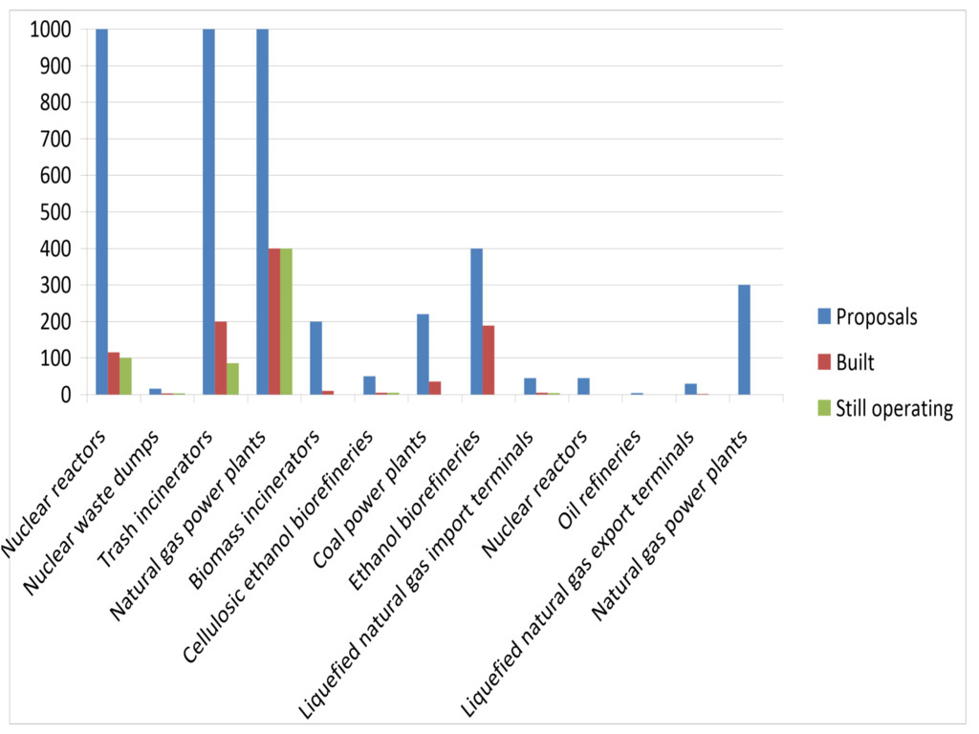
Grassroots Work Wins
(Most Proposed Energy and Waste Facilities Defeated)
Source: “The Power of Grassroots Resistance to Dirty Energy,” www.energyjustice.net/files/grassrootsresistance.pdf

Slide 4
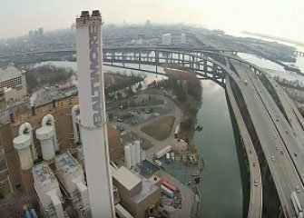
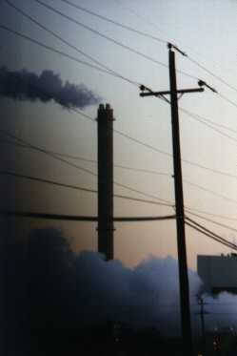
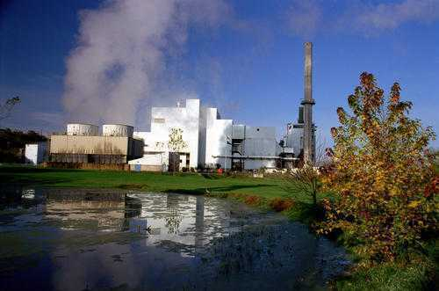
Trash Incineration
www.EnergyJustice.net/incineration/

Slide 5

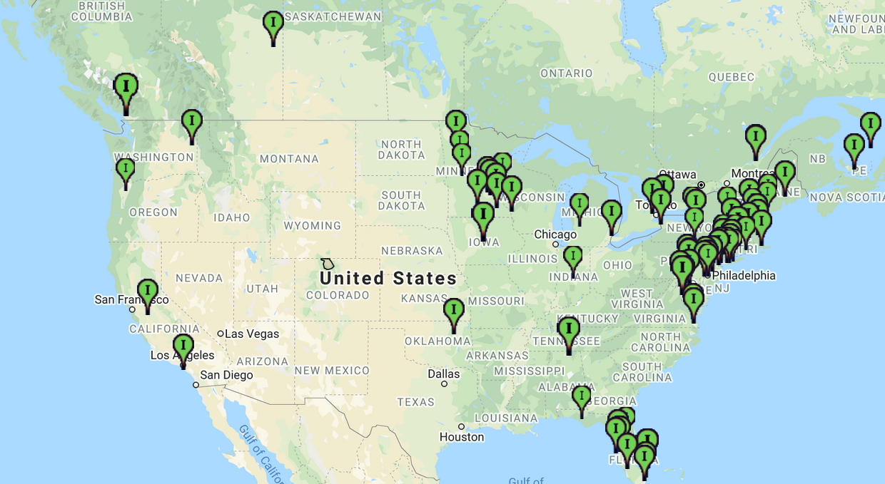

www.EnergyJustice.net/map

Slide 6
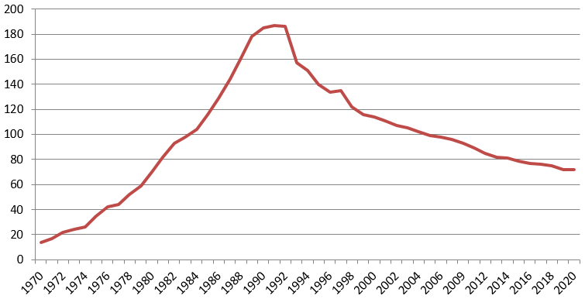
Number of Commercial Operating Trash Incinerators in the U.S.
Notes:
http://www.energyjustice.net/incineration

Slide 7

Incinerator Life Spans
Average life of the 14 trash incinerators closed since 2010 in the U.S.: 26 years.
Average lifespan of the 30 trash incinerators that have closed since 2000 was just
22 years.
Few trash incinerators operate beyond a
30-year life time.
Only one made it past 40 without being completely rebuilt, and is having serious problems.
  Rebuilding the Harrisburg, PA incinerator bankrupted the city.

Slide 8
Incinerator Life Spans
Covanta’s newest incinerator was aging at the ripe age of 22. In Maryland…
In 2016-2017, the incinerator experienced more downtime than usual, due to “much-needed plant maintenance.” The incinerator’s capacity and availability “is below industry standard” and has resulted in “high waste inventories” (larger piles of trash stored inside the plant).
“This reduced availability and capacity is a result of a lack of maintenance and repair on the boiler and air pollution control systems.”
Source: Covanta & Montgomery County Department of Environmental Protection.
See pp. 4 & 49 in www.montgomerycountymd.gov/SWS/Resources/Files/rrf/RCA%20Documents.pdf

Slide 9
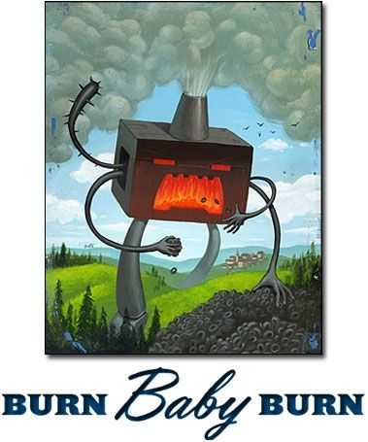
Incinerators: Names Used
Waste-to-energy (WTE)
Energy from Waste (EfW)
Trash-to-steam
Conversion technologies
Energy Recovery
Biomass
Advanced Thermal Tech
Waste to Fuel (WTF?)
Pyrolysis / Gasification / Plasma Arc
Policy buzzwords: “integrated” or “sustainable materials management”
Notes:
Defined and regulated as incinerators, even if they’re producing energy, or using two-stage gasification, pyrolysis or plasma processes. See U.S. EPA and EU definitions at bottom of http://www.energyjustice.net/incineration

Slide 10
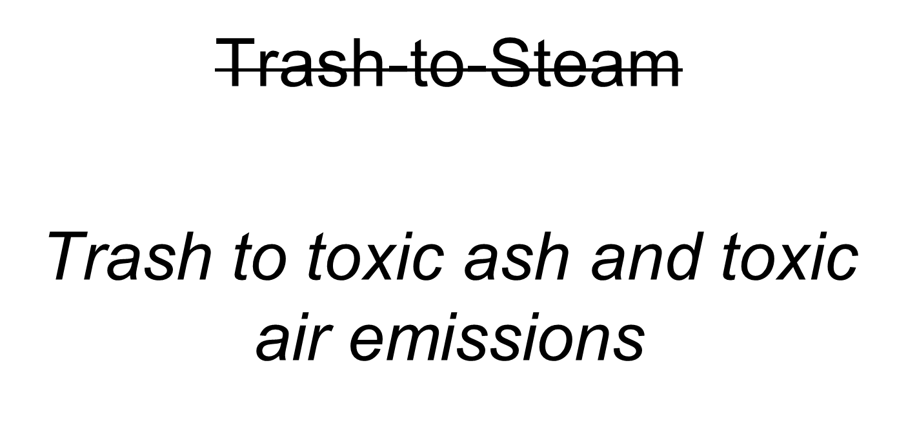
Incinerators are…

Slide 11
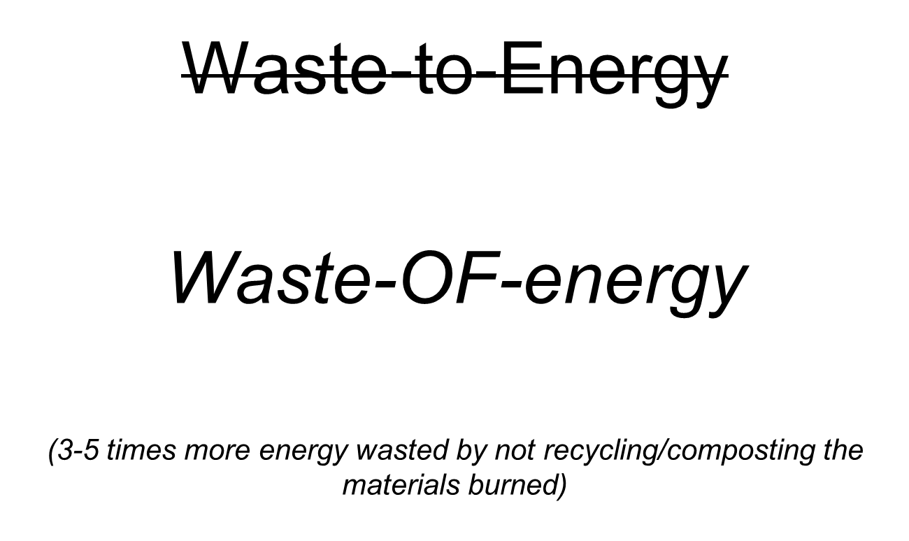
Incinerators are…
Source: Morris, Jeffrey, and Canzoneri, Diana, “Recycling Versus Incineration: An Energy Conservation Analysis,” Sound Resource Management Group (SRMG) Seattle, Washington, September, 1992. www.sciencedirect.com/science/article/pii/0304389495001166
Notes:
Embodied energy – papermaking example

Slide 12
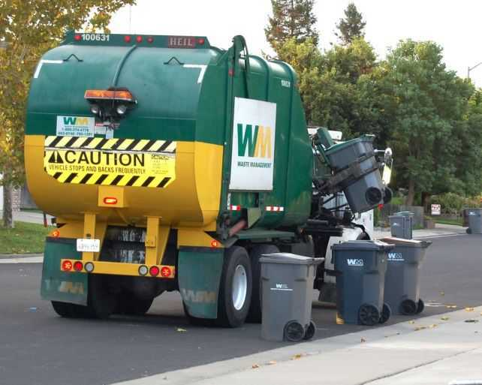
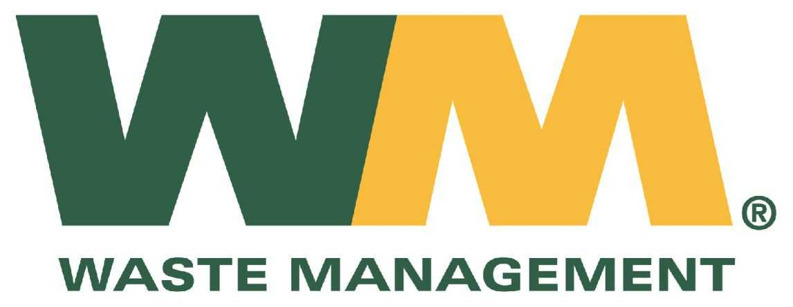

World’s largest waste corporation driving away from incineration
Jan 3, 2014: “Big Waste Hauler Rethinks Startups”
[pulls out of gasification, pyrolysis, plasma and trash-to-ethanol investments, selling off Agilyx, Enerkem, Fulcrum, Genomatica & InEnTec]
Jul 29, 2014: “Waste Management to Sell Wheelabrator for $1.94 Billion”
[pulls out of long-standing ownership of Wheelabrator, the second-largest operator of conventional incinerators in U.S.]
Notes:
Big Waste Hauler Rethinks Startups http://online.wsj.com/news/articles/SB20001424052702303640604579297003682735612
Waste Management to Sell Wheelabrator for $1.94 Billion http://www.wsj.com/articles/waste-management-to-sell-wheelabrator-for-1-94-billion-1406635577
See Bill Caesar presentation from Wastecon 2012 for list of WMI’s investments in startups.

Slide 13
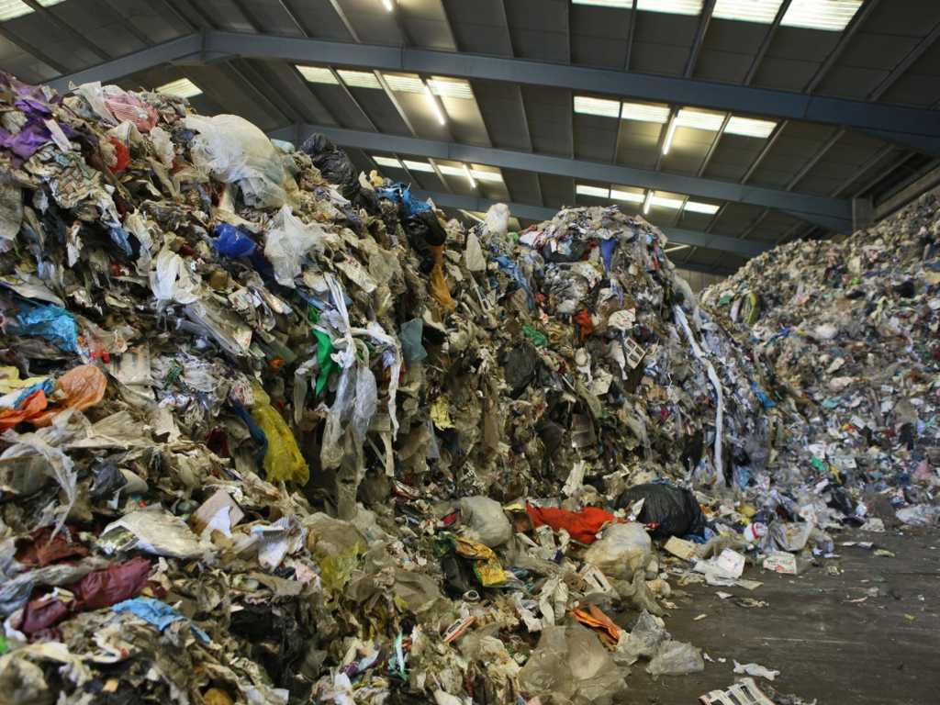
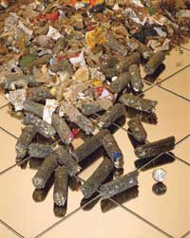
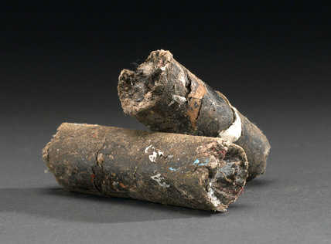
EPA: “Non-Hazardous Secondary Materials” rule
Waste is now “Fuel”
[Refuse-derived fuel (RDF) or “SpecFuel” or “Processed Engineered Fuel”]

Slide 14
Emerging Threats
Refuse-derived fuel (RDF)
(fuel pellets to burn in coal plants, cement kilns and other boilers)
  Processed Engineered Fuel
  SpecFuel
Waste to fuels
  Trash to ethanol, methanol, jet fuel, naphtha, asphalt…
Two-stage incinerators
  Pyrolysis
  Gasification
  Plasma Arc
Anaerobic digestion
  Digestated trash marketed as burnable fuel, or as fertilizer or soil amendment; ok if just to pre-process before landfill

Slide 15

Stop Greenwashing:
Hold Crayola Accountable
www.energyjustice.net/crayola

Slide 16
Experimental Types of Incinerators Don’t Work
Gasification, plasma arc and pyrolysis:
Can’t run continuously
Can’t be run effectively at commercial scale
Can’t process heterogenous feedstocks like trash
Companies with no real history bamboozle local officials into subsidizing projects that fail, technically and financially
The companies usually lie about their emissions, claiming zero emissions or “no smokestack”

Slide 17
EPA says pyrolysis/gasification = incineration
40 CFR 60.51a:
Municipal waste combustor, MWC, or municipal waste combustor unit: (1) Means any setting or equipment that combusts solid, liquid, or gasified MSW including, but not limited to, field-erected incinerators (with or without heat recovery), modular incinerators (starved-air or excess-air), boilers (i.e., steam-generating units), furnaces (whether suspension-fired, grate-fired, mass-fired, air curtain incinerators, or fluidized bed-fired), and pyrolysis/combustion units.
Pyrolysis/combustion unit means a unit that produces gases, liquids, or solids through the heating of MSW, and the gases, liquids, or solids produced are combusted and emissions vented to the atmosphere.
“A municipal waste incinerator 'combusts' solid waste and thus is functionally synonymous with municipal waste combustor.” (www.epa.gov/ttn/nsr/gen/rm_2.html)
Notes:
See bottom of http://www.energyjustice.net/incineration for links to U.S. Code of Federal Regulations and U.S. EPA sources.

Slide 18
Pyrolysis is a failed technology
Patent review company:
has been seeing pyrolysis projects for 14 years
none of them are legitimate
they're just splitting combustion into two steps, making it more expensive, less efficient and not any cleaner
sees a steady stream of guys in their 50s-70s who worked at corporations, thought it's a great idea, and go out and promote it and get money by whatever means and get some patent coverage mainly to help get the money, but none are legit

Slide 19
Pyrolysis is a failed technology
Rubber Manufacturers Association:
“Major tire companies like Goodyear and Firestone once invested ‘immense resources’ in pyrolysis but could not find markets for the byproducts or even a way to integrate them into their own products. And scores of start-ups have tried and failed to make money from tire pyrolysis.”
“The road is littered with the carnage of people who were trying to make this technology viable.”

Slide 20
Pyrolysis is a failed technology
Not intended for continuous operation
  Runs batch processes
  Mainly used at demonstration scale
Can only operate on homogenous fuels
Environmental Protection Agency:
While technically feasible, tire pyrolysis – a process in which tires are subjected to heat in an oxygen-starved environment and converted to gas, oil and carbon char – has been inhibited by the high capital investment required and steep operating costs

Slide 21
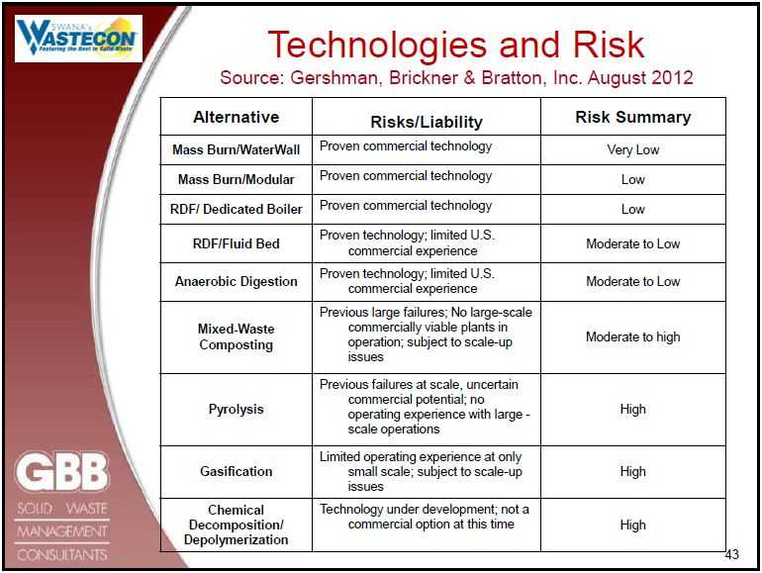

Slide 22
Basic Lessons
Garbage-in, Garbage-out.
Nothing is 100%.
Small amounts matter, especially if they're a small % of a BIG number.
If incineration is the answer, someone asked the wrong question
Makes the problem “invisible” rather than making it very visible so that unsustainably-produced products can be properly dealt with

Slide 23
Most Expensive Way to Manage Waste
“Waste-to-energy is an additional capital cost. That is not in dispute, compared to a landfill... compared to a landfill, which is a less capital-intense structure – it is more expensive. If you had a landfill next to a waste-to-energy facility, then almost in every case, you would think the landfill is going to be cheaper.”
Ted Michaels, President, Energy Recovery Council, March 18, 2013 testimony before Washington, DC City Council
Notes:
Source video available here: http://www.energyjustice.net/incineration/expensive-waste
Most incinerator revenue comes from tip fees, not energy sales.

Slide 24
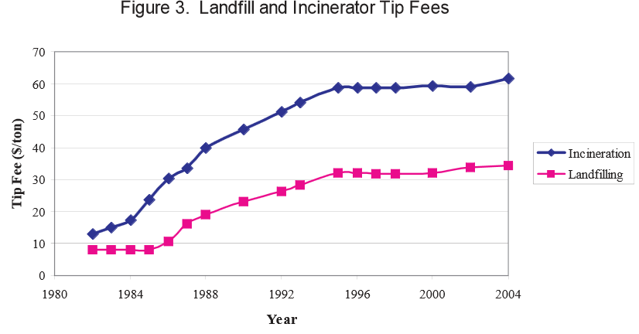
Most Expensive Way to Manage Waste
Source: National Solid Waste Management Association 2005 Tip Fee Survey, p4. www.environmentalistseveryday.org/docs/Tipping-Fee-Bulletin-2005.pdf

Slide 25
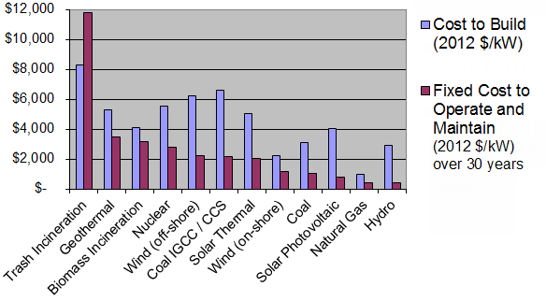
Most Expensive Way to Make Energy
Source: "Updated Capital Cost Estimates for Utility Scale Electricity Generating Plants," Energy Information Administration, April 2013, p.6, Table 1. Full report here: www.eia.gov/forecasts/capitalcost/pdf/updated_capcost.pdf

Slide 26
Incinerator Economics
Capital Intensive (Expensive)
Requires long-term monopoly contracts "Put-or-Pay" contracts including “put or pay” clauses that punish local governments if they recycle / compost
Competes with zero waste AND energy alternatives
  Competes with wind and solar in Renewable Portfolio Standards*
Economic incentives encourage burning more dangerous wastes (getting paid to take waste vs. paying for fuels)
Can’t compete with cheap electricity. Steam sales more lucrative.
* Currently, trash incineration is only in direct competition with wind and solar in Maryland’s RPS law, but this affects many other states, and biomass incineration and landfill gas burning competes directly with wind and solar in most RPS laws.

Slide 27
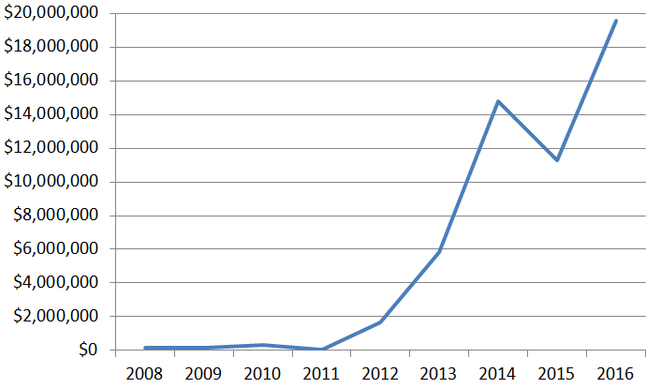

Maryland ratepayer money to trash incinerators via Renewable Energy Credits
(Incineration promoted to Tier 1 – equal to wind – in 2011.)
Notes:
http://www.energyjustice.net/md

Slide 28
Incineration Competes
with Recycling Composting
OLD THOUGHT: needs paper and plastics to burn effectively
NEW UNDERSTANDING: competes more with composting
Must be fed enough waste
“Put or pay” waste contracts punish zero waste efforts

Slide 29
Incinerators Burn Money
Harrisburg, PA: incinerator was primarily responsible for bankrupting Pennsylvania’s capital city
Claremont, NH: 20-year “put-or-pay” contracts caused 29 towns to file for bankruptcy in 1993, which the court denied, requiring that taxes be raised to pay back the incinerator for waste the towns did not even produce
Hudson Falls, NY and Lake County, FL – deep incinerator debt due to long-term contracts favorable to the industry
Poughkeepsie, NY – incinerator fails to bring in enough revenue from tipping fees and electric sales to operate without millions in annual subsidies from the county
Detroit, MI – the nation’s largest incinerators by design capacity – has cost the ailing city $1.2 billion in debt payments over 20 years, bringing the city close to bankruptcy on three occasions.
All of New Jersey’s five trash incinerators had to be bailed out by the state taxpayers with over $1.5 Billion because they could not attract enough waste to operate at capacity.
Notes:
http://www.no-burn.org/downloads/Burning%20Public%20Money%20GAIA%202011_2.pdf

Slide 30
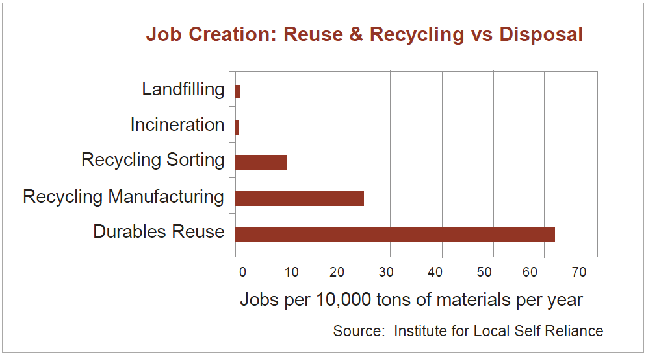
Worst Way to Create Jobs
Notes:
http://ilsr.org/recycling-means-business/

Slide 31
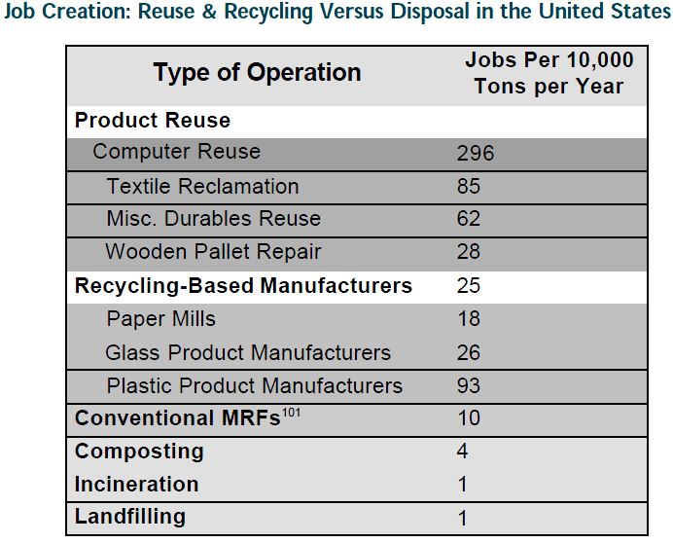
Notes:
http://ilsr.org/recycling-means-business/

Slide 32
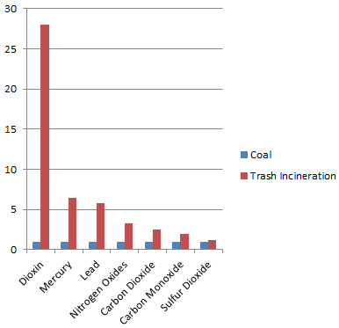
Incineration Worse than Coal
Toxic Air Emissions are…
Dioxins / furans (28 times)
Mercury (6-14 times)
Lead (6 times)
Nitrogen Oxides (NOx) (3.2 times)
Carbon Monoxide (CO) (1.9 times)
Sulfur Dioxide (SO₂) (70% worse)
Carbon Dioxide (CO₂) (2.5 times)
www.energyjustice.net/incineration/worsethancoal

Slide 33
Incinerator, Not a Power Plant
“a waste-to-energy plant is designed to manage solid waste... the electricity output is a secondary function”
Ted Michaels, President, Energy Recovery Council, March 18, 2013 testimony before Washington, DC City Council
Notes:
http://www.energyjustice.net/incineration/waste-to-energy – see footnote 4

Slide 34
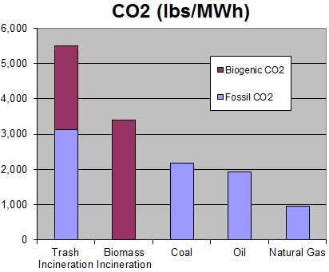
Global Warming Pollution
Smokestack CO2 Emissions from U.S. Power Plants
Data is in pounds of CO2 per unit of energy produced (lbs/MWh)
Source: U.S. EPA Emissions & Generation Resource Integrated Database (eGRID) v.9, released 2/24/2014
(2010 data)
Notes:
EPA eGRID data source, data and methodology available at: http://www.energyjustice.net/egrid

Slide 35

Dioxins & Furans
Most toxic chemicals known to science: 140,000 times more toxic than mercury.
Cause infertility, learning disabilities, endometriosis, birth defects, sexual reproductive disorders, damage to the immune system, cancer and more.
93% of dioxin exposure is from eating meat and dairy products.
  It takes 14 years for a human to
  inhale as much dioxin as a grazing
  cow will ingest in one day.
  Highest exposure is during infancy.
www.ejnet.org/dioxin/

Slide 36
Exposure to Dioxins
Source: U.S. Environmental Protection Agency, “Estimating Exposure to Dioxin-Like Compounds – Volume 1: Executive Summary,” June 1994.
Notes:
Chart is from p37 of the review draft of U.S. Environmental Protection Agency's "Estimating Exposure to Dioxin-Like Compounds – Volume 1: Executive Summary" June 1994. It can be found on the Dioxin Homepage: http://www.ejnet.org/dioxin/
Newer estimates can be found in Table 4-30 (p4-110) in Part 1, Volume 2, Chapter 4 of U.S. Environmental Protection Agency's "Exposure and Human Health Reassessment of 2,3,7,8-Tetrachlorodibenzo-p-Dioxin (TCDD) and Related Compounds National Academy Sciences (NAS) Review Draft.” http://www.epa.gov/ncea/pdfs/dioxin/nas-review/
The table is on p100 of: http://www.epa.gov/ncea/pdfs/dioxin/nas-review/pdfs/part1_vol2/dioxin_pt1_vol2_ch04_dec2003.pdf

Slide 37
How to make dioxin
Dioxins are created by burning hydrocarbons with chlorine in the presence of oxygen.
Dioxin emissions increase when:
  More chlorine is in the fuel/waste stream
  Certain metal catalysts are present (Copper, Iron, Zinc…)
  The gases stay in a low temperature range
  (200-450º C)
  Much is formed on the ash as it cools.
  Carbon injection used to reduce dioxin
  air emissions increases dioxins, but
  transfers them to the ash.
Notes:
Copper (Cu) is the most potent catalyst for dioxin formation, but Iron (Fe), Zinc (Zn), Potassium (K) and Sodium (Na) have also been found in multiple studies to be correlated with increased dioxin/furan formation. Some studies have also indicated that Manganese (Mn), Magnesium (Mg) and Nickel (Ni) may also serve as catalysts for dioxin formation.
See studies here: http://www.ejnet.org/dioxin/catalysts.html
“Temperature of the combustion gases (i.e., flue gases) is perhaps the single most important factor in forming dioxin-like compounds. Temperatures between 200° and 450° Celsius (C) are most conducive to forming CDD/CDFs, with maximum formation occurring at around 350°C. If temperature falls outside this range in temperature, the amount of CDD/CDFs formed is minimized.”
Pages 2-3 of Part 1, Volume 1, Chapter 2 of U.S. Environmental Protection Agency's "Exposure and Human Health Reassessment of 2,3,7,8-Tetrachlorodibenzo-p-Dioxin (TCDD) and Related Compounds National Academy Sciences (NAS) Review Draft.” http://www.epa.gov/ncea/pdfs/dioxin/nas-review/
http://www.epa.gov/ncea/pdfs/dioxin/nas-review/pdfs/part1_vol1/dioxin_pt1_vol1_ch02_dec2003.pdf
Research on the role of chlorine in the fuel/waste stream can also be found in that chapter.

Slide 38

The Smokestack Story
Continuous Emissions Monitors (CEMs) tell all
Rigorous enforcement by the state
Emissions limits = health & safety

Slide 39
The Smokestack Story
Continuous Emissions Monitors (CEMs) tell all
  CEMs only cover a few pollutants; others tested annually
  Some companies rig stack tests and CEMs data
Rigorous enforcement by the state
  Not all violations result in fines
  Fines not enough to change behavior
Emissions limits = health & safety
  Not based on health & safety at all
  Technology-based standard
  Concentration-based limits mean
  larger facilities can polluter more

Slide 40


Continuous Emissions Monitors
www.ejnet.org/toxics/cems
Notes:
Without continuous emissions testing, no one really knows how much pollution is being released into the air. Corporations like it this way. Infrequent testing makes it easy for them to manipulate test results and look cleaner than they really are. Work to get the local, state or national government to require continuous monitoring. Pressure the corporations directly to provide this. If they refuse, ask "what are you hiding?" Demand that test results be made available immediately on a website and that summaries be published weekly in local newspapers.
The U.S. EPA has a program that verifies monitoring technologies. See: http://www.epa.gov/nrmrl/std/etv/verifiedtechnologies.html
Emissions limits are meaningless if there is not adequate testing to ensure that they are being met. Most regulated pollutants are required to be tested once per year, or once ever. This is akin to having a speeding limit but allowing drivers to drive with no odometer. Once per year, a speed trap would be set, but drivers would be warned ahead of time so they can slow down, and the driver’s brother would be managing the speed trap (the companies do their own testing). Regulating air polluting facilities in this manner is inexcusable, especially in the age where continuous testing technology exists and where the data is able to be made available to the public real-time through a website.
Annual stack tests are inadequate, in part, because they are done by the applicant, under optimal performance, rather than capturing the day-to-day reality of operations. Emissions can be far higher during startup, shutdown, and malfunction times – especially for such temperature-sensitive pollutants like dioxins/furans (where a study has shown emissions to be 32-52 times higher in reality -- as measured with long-term samplers -- than annual stack tests show).
The technology exists to do continuous monitoring of the following additional pollutants: Carbon Dioxide (CO2), Particulate Matter, Nitrous Oxide (N2O), Hydrogen Sulfide (H2S), Hydrofluoric Acid (HF), Hydrochloric Acid (HCl), Hydrogen Cyanide, Volatile Organic Compounds (VOCs), Methane, Ethylene, Acetylene, Methanol, Antimony, Arsenic, Barium, Bromine, Cadmium, Calcium, Chromium, Cobalt, Copper, Iron, Lead, Manganese, Mercury, Nickel, Selenium, Silver, Thallium, Tin, Titanium, Vanadium, Zinc, Ammonia, Dioxins & furans, Polycyclic Aromatic Hydrocarbons (PAHs) and Vinyl Chloride Monomer. Wevers M. and De Fr頒., “Underestimation of dioxin emission inventories,” Organohalogen Compounds, Vol. 36, pp. 19-20 (1998). http://www.ejnet.org/toxics/cems/1998_DeFre_OrgComp98_Underest_DIoxin_Em_Inv_Amesa.pdf

Slide 41
Continuous Emissions Monitors
Only generally used for 3 pollutants: sulfur oxides (SOx), nitrogen oxides (NOx) and carbon monoxide (CO) plus opacity, oxygen and temperature
Actual emissions of dioxins 30-50 times higher
Technology now exists to continuously monitor:
Ammonia (NH₄)
Carbon Dioxide (CO₂)
Hydrogen Sulfide (H₂S)
Acid Gases:
  Sulfuric Acid (H₂SO₄)
  Hydrofluoric Acid (HF)
  Hydrochloric Acid (HCl)
Products of Incomplete Combustion (PICs):
  Dioxins & Furans
  Polycyclic Aromatic Hydrocarbons (PAHs)
  Volatile Organic Compounds (VOCs)
  Particulate Matter (PM)
Metals:
  Antimony (Sb)
  Arsenic (As)
  Barium (Ba)
  Cadmium (Cd)
  Chromium (Cr)
  Lead (Pb)
  Manganese (Mn)
  Mercury (Hg)
  Silver (Ag)
  Nickel (Ni)
  Zinc (Zn)
  …and more
www.ejnet.org/toxics/cems
Notes:
Without continuous emissions testing, no one really knows how much pollution is being released into the air. Corporations like it this way. Infrequent testing makes it easy for them to manipulate test results and look cleaner than they really are. Work to get the local, state or national government to require continuous monitoring. Pressure the corporations directly to provide this. If they refuse, ask "what are you hiding?" Demand that test results be made available immediately on a website and that summaries be published weekly in local newspapers.
The U.S. EPA has a program that verifies monitoring technologies. See: http://www.epa.gov/nrmrl/std/etv/verifiedtechnologies.html
Emissions limits are meaningless if there is not adequate testing to ensure that they are being met. Most regulated pollutants are required to be tested once per year, or once ever. This is akin to having a speeding limit but allowing drivers to drive with no odometer. Once per year, a speed trap would be set, but drivers would be warned ahead of time so they can slow down, and the driver’s brother would be managing the speed trap (the companies do their own testing). Regulating air polluting facilities in this manner is inexcusable, especially in the age where continuous testing technology exists and where the data is able to be made available to the public real-time through a website.
Annual stack tests are inadequate, in part, because they are done by the applicant, under optimal performance, rather than capturing the day-to-day reality of operations. Emissions can be far higher during startup, shutdown, and malfunction times – especially for such temperature-sensitive pollutants like dioxins/furans (where a study has shown emissions to be 32-52 times higher in reality -- as measured with long-term samplers -- than annual stack tests show).
The technology exists to do continuous monitoring of the following additional pollutants: Carbon Dioxide (CO2), Particulate Matter, Nitrous Oxide (N2O), Hydrogen Sulfide (H2S), Hydrofluoric Acid (HF), Hydrochloric Acid (HCl), Hydrogen Cyanide, Volatile Organic Compounds (VOCs), Methane, Ethylene, Acetylene, Methanol, Antimony, Arsenic, Barium, Bromine, Cadmium, Calcium, Chromium, Cobalt, Copper, Iron, Lead, Manganese, Mercury, Nickel, Selenium, Silver, Thallium, Tin, Titanium, Vanadium, Zinc, Ammonia, Dioxins & furans, Polycyclic Aromatic Hydrocarbons (PAHs) and Vinyl Chloride Monomer. Wevers M. and De Fr頒., “Underestimation of dioxin emission inventories,” Organohalogen Compounds, Vol. 36, pp. 19-20 (1998). http://www.ejnet.org/toxics/cems/1998_DeFre_OrgComp98_Underest_DIoxin_Em_Inv_Amesa.pdf

Slide 42

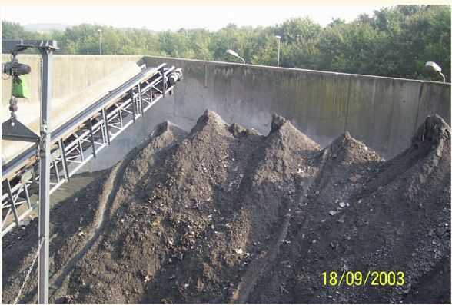
Incinerator Ash
Incinerators still require landfills for their toxic ash
30 tons of ash produced for every 100 tons burned
Ash leaches more readily, can blow off of trucks, and off of landfills where it’s often used as cover
Notes:
If you pour water over coffee beans, you won’t make coffee, but if you grind up those same beans, creating a high surface area and exposing the inside of the beans, water running over it will carry the contents with it and make coffee. Incineration increases the surface area of the burned trash, enabling toxic metals and other chemicals to readily escape plastics or other materials they were previously bound up with.

Slide 43
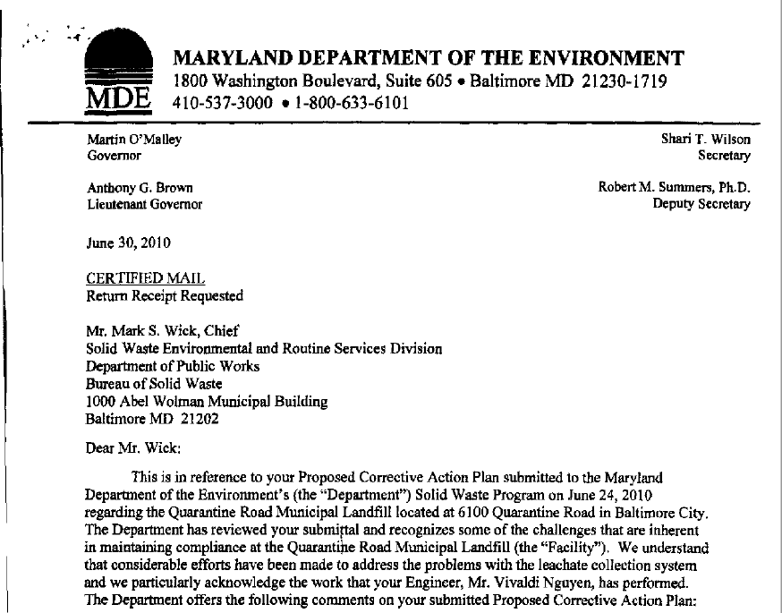

Slide 44
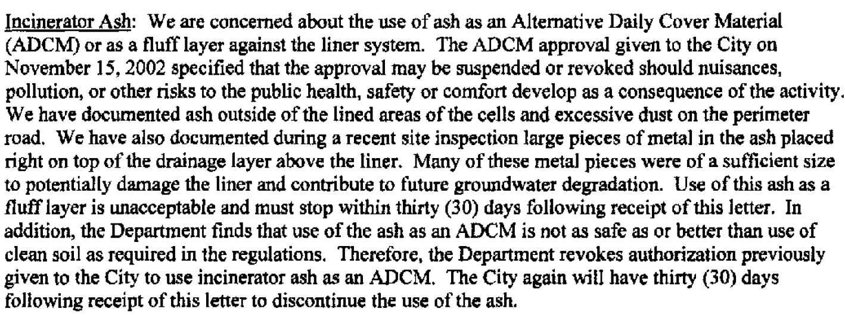
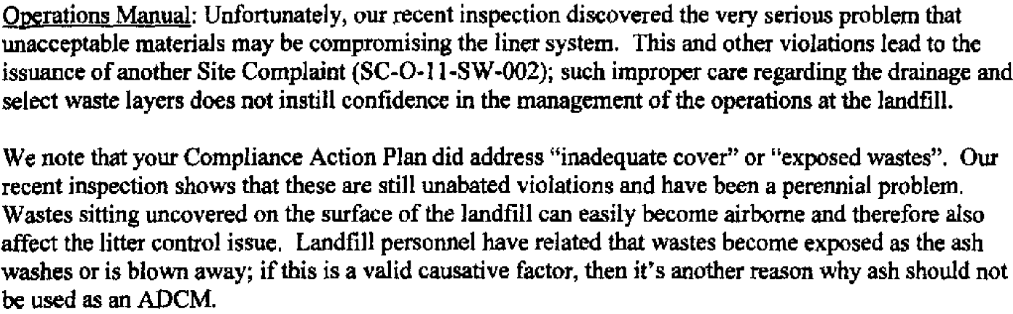

Slide 45
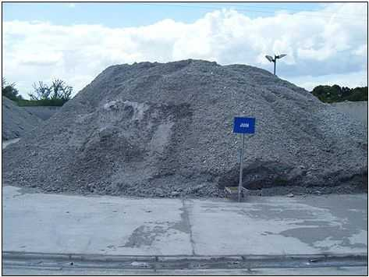
Incinerator Ash = Hazardous Waste
Incinerator ash is toxic, but the U.S. EPA allows a special test that enables it to test as non-hazardous, saving the industry a lot of money
Despite Canada relying on the same test, Vancouver’s incinerator ash is leaching toxic cadmium at levels about twice the province’s acceptable limits. They’ve had to ship the hazardous ash to a hazardous waste landfill in Alberta.
Notes:
On Vancouver:
http://www.theglobeandmail.com/news/british-columbia/costs-adding-up-as-incinerator-ash-being-shipped-to-alberta/article5989220/
http://www.theglobeandmail.com/news/british-columbia/toxic-ash-testing-clouds-incinerator-plans/article5032738/
http://www.biv.com/article/2014/11/metro-vancouver-sewage-board-sues-garbage-incinera/
http://www.cbc.ca/news/canada/british-columbia/b-c-investigates-toxic-ash-at-cache-creek-landfill-1.1292090
http://www.burnabynow.com/news/update-burnaby-incinerator-fails-several-toxicity-tests-1.623832
On ash testing requirements in the U.S.:
In May 1994, the U.S. Supreme Court made a ruling that incinerator ash that tests hazardous for toxic heavy metals such as lead and cadmium must be disposed of in hazardous waste landfills rather than in solid waste dumps. If incinerators were made to pay for the expense of disposing of their ash as hazardous waste (which it is, and is defined as such in international law), they'd be out of business overnight.
To get around this, the EPA has allowed the following:
1) The switching from a test (EP Tox test) that used to find fly ash hazardous 94% percent of the time, bottom ash 36% of the time, and combined ash 40% of the time -- to the Toxicity Characteristic Leaching Procedure (TCLP) test, which changed the pH requirements in a way that allows the test to be conducted at a pH where lead doesn't leach out, saving the industry from a hazardous waste designation. Lead was the leading cause of ash failing the EP Tox test.
2) Not testing for what's in the ash, but just what leaches out under pH-manipulated conditions.
3) Mixing of fly ash and bottom ash prior to testing, to dilute the toxicity of the fly ash. Also, the use of lime injection in scrubbers makes the ash very basic (around pH 12), where lead will leach if tested with water, but the TCLP test uses acid to lower the pH just enough so that lead won't leach -- but not to the fixed pH of 5 that the EP Tox test required, where lead leaches again. The mixing of the ash prior to testing enables the lime in the fly ash to also protect the bottom ash from failing the test. Most of the metals have a U-shaped solubility curve (so it leaches at high and low pH, but not so much in the middle), and the test can make it look like certain metals won't leach out, though in real-life disposal conditions, over time, the shifting pH will cause it to leach. See solubility curves on slide 7 here: http://cpe.njit.edu/dlnotes/CHE685/Cls06-2.pdf and more on lead, here: http://144.206.159.178/ft/1092/47128/841218.pdf
4) Allowing incinerators to store ash on-site for months so they can keep treating or diluting it until it passes the test. Some incinerators have been known to send many ash samples to a lab until one passes, then they use the good results to report to the state. One of the many tricks employed by incinerator operators to help them pass the TCLP test is to treat the fly ash with phosphoric acid prior to the testing. The phosphoric acid converts the soluble lead into the highly insoluble substance lead phosphate, thereby fixing the lead in the ash long enough to pass the test, but lead phosphate may not tie up lead indefinitely in the landfill, since phosphate is known to be a nutrient for all living things including microorganisms.
5) Incinerator ash only has to be tested 4 times a year (the waste stream is highly variable and ash composition can change frequently).
This series is required reading on this topic:
http://www.americanhealthstudies.org/wastenot/wn280.htm
http://www.americanhealthstudies.org/wastenot/wn315.htm
http://www.americanhealthstudies.org/wastenot/wn316.htm
http://www.americanhealthstudies.org/wastenot/wn317.htm
[apologies that the tables and graphs don't show up as they do in the original hardcopies]

Slide 46
How Incinerator Ash Escapes being Hazardous Waste
City of Chicago v. Environmental Defense Fund, 511 U.S. 328 (1994).
May 2, 1994: U.S. Supreme Court rules that incinerator ash which tests hazardous for toxic heavy metals such as lead and cadmium must be disposed of in hazardous waste landfills rather than in municipal solid waste landfills.
If incinerators were made to pay for the expense of disposing of their ash as hazardous waste, they'd be out of business overnight.

Slide 47
How Incinerator Ash Escapes being Hazardous Waste
Switching the test. EPA allowed the industry to switch from the EP Tox test to the TCLP test.
  EP Tox Test used to find fly ash hazardous 94% percent of the time, bottom ash 36% of the time, and combined ash 40% of the time
  Toxicity Characteristic Leaching Procedure (TCLP) test uses different pH requirements that allow the test to be conducted at a neutral pH where lead doesn't leach out, saving the industry from a hazardous waste designation. Lead and cadmium were the leading causes of ash failing the EP Tox test.
  Neither test looks at what’s in the ash. They look just at what leaches out under short-term pH-manipulated lab conditions.
Notes:
https://www.epa.gov/hw-sw846/sw-846-test-method-1311-toxicity-characteristic-leaching-procedure

Slide 48
How Incinerator Ash Escapes being Hazardous Waste
2) Mixing of fly ash and bottom ash prior to testing.
  Dilutes the toxicity of the fly ash.
  Lime injection in scrubbers (air pollution controls) makes the ash very basic (around pH 12), where lead will leach if tested with water, but the TCLP test uses acid to lower the pH just enough so that lead won't leach – but not to the fixed pH of 5 that the EP Tox test required, where lead leaches again.
  Mixing of the ash prior to testing enables the lime in the fly ash to also protect the bottom ash from failing the test.
  Most of the metals have a U-shaped solubility curve (so it leaches at high and low pH, but not so much in the middle, at a neutral pH). The test can make it look like certain metals won't leach out, though in real-life disposal conditions, over time, the shifting pH will cause it to leach.

Slide 49
How Incinerator Ash Escapes being Hazardous Waste
3) Allowing incinerators to store ash on-site for months so they can keep treating or diluting it until it passes the test. Some incinerators have been known to send many ash samples to a lab until one passes, then they use the good results to report to the state.
One trick used by incinerator operators to pass the TCLP test is to treat the fly ash with phosphoric acid prior to testing. Phosphoric acid converts the soluble lead into the highly insoluble substance lead phosphate, fixing the lead in the ash long enough to pass the test. However, lead phosphate may not tie up lead indefinitely in the landfill, since phosphate is a nutrient for all living things, including microorganisms.
4) Incinerator ash only has to be tested 4 times a year. The waste stream is highly variable and ash composition can change frequently.

Slide 50
Incineration Worse than Landfills
Incinerators still require landfills for their toxic ash
Choice is NOT landfill vs. incinerator, but:
landfill
vs.
incinerator AND a smaller, more toxic landfill

Slide 51
Incineration Worse than Landfills
Incinerators still require landfills for their toxic ash
Choice is NOT landfill vs. incinerator, but:
landfill
vs.
incinerator AND a smaller, more toxic landfill
OR…
Zero Waste and minimal landfilling

Slide 52
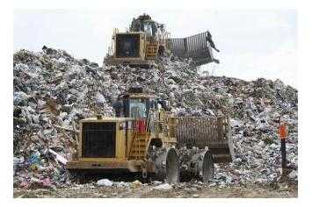
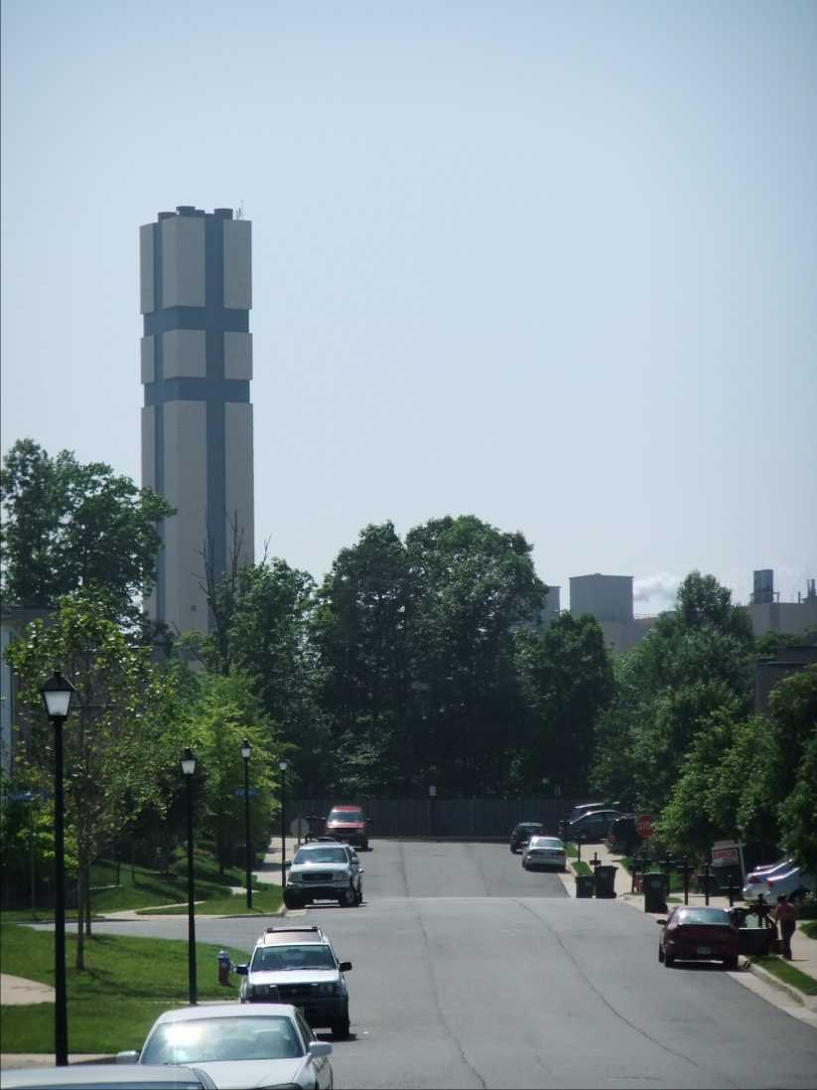
Landfilling vs. Incineration

Slide 53
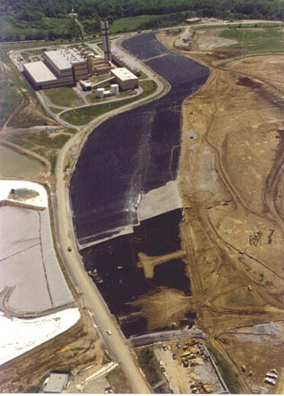
Landfilling vs. Incineration
…and Ash Landfilling
Notes:
I-95 Landfill image from: http://www.fairfaxcounty.gov/dpwes/trash/dispcapp.htm

Slide 54
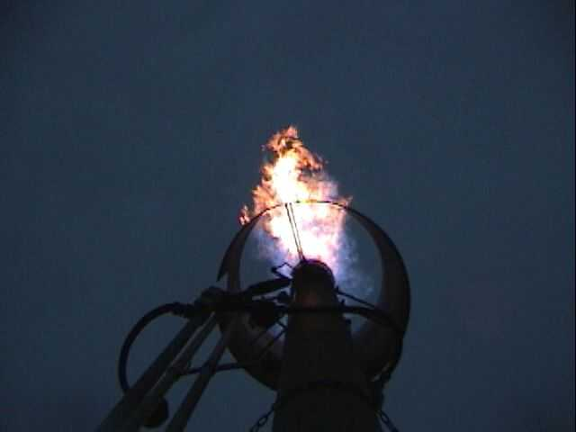
Landfills and Landfill Gas Burning
www.energyjustice.net/lfg/

Slide 55
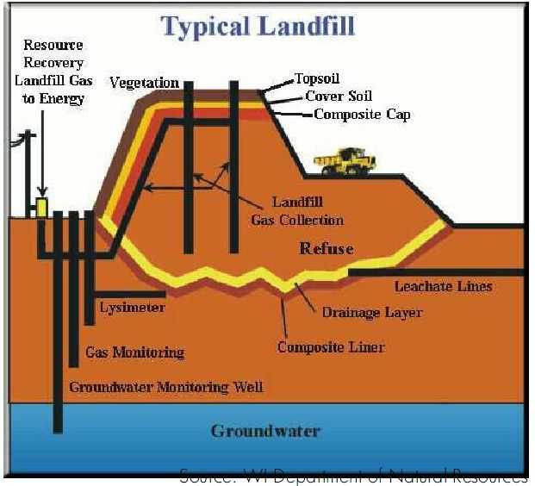

Slide 56
All Landfills Leak
U.S. EPA acknowledges that all landfill liners leak within 20 years, if not sooner
Landfill liners are only guaranteed for about 20 years
Landfills are permitted to leak a certain amount of gallons/acre
It's easy not to find leakage (underground or in air); testing is often inadequate

Slide 57
Landfill Gas: What it is…
Not simply “methane”
About half methane, half CO₂
Organics breaking down create the methane; methane helps the toxic chemicals escape
Hundreds of toxic contaminants
  Halogenated compounds (trichloroethane, vinyl chloride, carbon tetrachloride and many more)
  Mercury (methylmercury – the really bad kind)
  Sulfur compounds (the stinky stuff)
  Tritium (radioactive)
  Other toxic organic compounds (benzene , toluene…)

Slide 59
Landfill Health Impacts
A New York study of 38 landfills found that women living near solid waste landfills where gas is escaping have a four-fold increased chance of bladder cancer or leukemia.
“Investigation of Cancer Incidence and Residence Near 38 Landfills With Soil Gas Migration Conditions, New York State, 1980-1989,” State of New York Department of Health, (Atlanta, Ga: Agency for Toxic Substances and Disease Registry, June, 1998).

Slide 60
Landfilling vs. Incineration
Pollutant (all data in tons) | Incinerators | Landfills | Incinerators are __ times as polluting
Greenhouse Gases (CO₂e) | 482,770 | 268,763 | 1.8
Health Damaging Pollution | 1,975 | 1,236 | 1.6
Carbon Monoxide (CO) | 119 | 22 | 5
Hydrochloric Acid (HCl) | 17 | 1 | 21
Nitrogen Oxides (NOx) | 625 | 6 | 105
Particulate Matter (Condensable) | 25 | 1 | 17
Particulate Matter (PM10) | 26 | 17 | 1.6
Fine Particulate Matter (PM2.5) | 17 | 4 | 5
Sulfur Oxides (SOx) | 55 | 3 | 19
Total Suspended Particulate | 2,178 | 2,486 | 0.88
Volatile Organic Compounds | 3 | 9 | 0.34
Source: PA Dept of Environmental Protection Air Emissions Report, 2017 data for southeast & southcentral region facilities

Slide 61

How to Compare?
Human health impacts
  Nitrogen Oxide emissions (asthma)
  Particulate emissions
  Toxic and Cancer-causing emissions
Eutrophication
Acidification (acid rain…)
Ecosystem toxicity
Ozone depletion
Smog formation
Global warming
Should also look at…
  Cost
  Jobs
  Population impacted
  Environmental justice

Slide 62
Life Cycle Analysis on DC Waste Options
Analysis done by:
Jeffrey Morris, Ph.D. (Economics)
Sound Resource Management Group
360-867-1033
jeff.morris@zerowaste.com
www.zerowaste.com
Dr. Morris authored several peer reviewed published studies on waste systems.

Slide 63
LCA Characteristics of WARM, MSW DST and MEBCalc
 | LCA Model
Features | WARM | MSW DST | MEBCalc
Impacts included in model
-Climate change | ✔ | ✔ | ✔
-Human health (respiratory) |  | limited | ✔
-Human health (toxic chemicals) |  | limited | ✔
-Human health (carcinogens) |  | limited | ✔
-Eutrophication |  | limited | ✔
-Acidification |  | limited | ✔
-Eco-toxicity |  | limited | ✔
-Ozone depletion |  |  | ✔
-Smog formation |  | limited | ✔
Monetized Environmental Score |  |  | ✔
Energy Impacts Included | ✔ | ✔ | limited
# of MSW Materials Included | 54 | ~30 | 27
Additional Comparison of WARM & MSW DST: H. Scott Matthews (Carnegie Mellon University), Cynthia J. Manson (Industrial Economics, Inc.), Comparative Analysis of EPA Life Cycle Models: Differences between MSW-DST and WARM in Examining Waste Management Options, prepared for EPA Office of Resource Conservation and Recovery, Internal Review Draft-Do Not Distribute, 11-12-2009.

Slide 64

Data Sources
U.S. EPA
  National Emissions Inventory
  Emissions & Generation Resource Integrated Database (eGRID)
  FLIGHT (Greenhouse gas inventory)
  Landfill Methane Outreach Program database
U.S. Energy Information Administration
  Form 860 database (Annual Electric Generator data)
  Form 923 database (Annual Electric Utility Data)
Virginia Department of Environmental Quality
DC Department of
Public Works
Energy Recovery Council
Sound Resource
Management Group

Slide 65
Where DC’s waste went (to VA) in 2016:
Covanta Fairfax | 222,937 | 27%
Shoosmith Sanitary Landfill | 221,415 | 27%
Middle Peninsula Landfill and Recycling Facility | 190,323 | 23%
BFI Old Dominion Landfill | 118,785 | 14%
Tri City Regional Disposal and Recycling Services | 36,898 | 4%
King George Landfill & Recycling Center | 20,002 | 2%
Covanta Alexandria Arlington | 16,690 | 2%
King and Queen Sanitary Landfill | 267 | 0%
Charles City County Landfill | 18 | 0%
Total: | 827,335

Slide 66
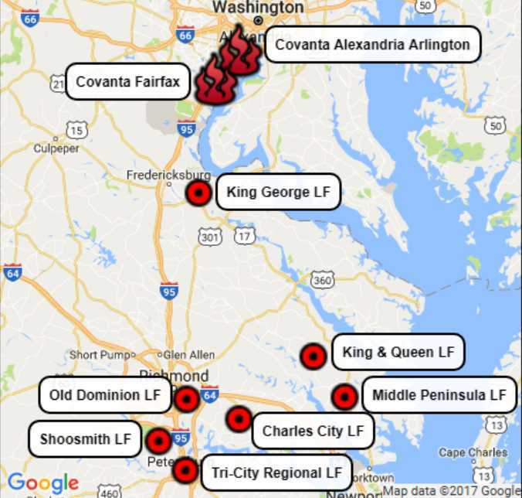
Where DC’s waste went (to VA) in 2016:

Slide 67
Facilities in Focus for 2017
& This Presentation
Facility Name | Type | Average Distance from DC Transfer Stations (mi) | Annual Precipitation (inches) | Years of Life Remaining
Covanta Fairfax | Incinerator | 26 |  | 13 (if it lives to 40)
King George | Landfill | 68 | 42.8 | 11
King & Queen | Landfill | 122 | 45.4 | 26
Middle Peninsula | Landfill | 130 | 45.4 | 73
Charles City | Landfill | 130 | 46.3 | 74
[“Other 3 Landfills” in future slides refers to the last three above, which are all about the same distance from DC.]

Slide 68
Covanta Fairfax Reported Emissions (2014)
Global Warming Pollutants | Pounds released (2014)
Carbon Dioxide (CO2) | 2,169,540,876
Methane (CH4) | 762,927
Nitrous Oxide (N2O) | 100,130
Health Damaging Pollutants | Pounds released (2014)
Carbon Monoxide | 11,319
Hydrochloric Acid | 57,408
Hydrofluoric Acid | 1,385
Lead | 68
Nitrogen Oxides (NOx) | 3,398,301
Particulate Matter (PM10) | 14,709
Fine Particulate Matter (PM2.5) | 8,862
Sulfur Dioxide | 257,899
Volatile Organic Compounds | 11,813

Slide 69
Covanta Fairfax Emissions
Within 20 miles of DC’s borders, Covanta Fairfax is…
#1 in Nitrogen Oxides
  So high that Covanta’s home state of New Jersey singled out this incinerator as ineligible to sell renewable energy credits to NJ
  #2 in the entire industry, worse than the Detroit incinerator (which has no NOx controls)
#1 in Carbon Dioxide
#1 in Hydrochloric Acid
#1 in Hydrofluoric Acid (was worst in their industry in 2008)
#1 in Mercury
#4 in Sulfur Dioxide
Top 10 in Lead
#3 in overall air pollution (after Dulles and DCA Airports)

Slide 70
Life Cycle Analysis on DC Waste Options
All comparison data includes pollution from trucking.
  Note the tiny difference that doubling hauling distance makes.
A 75% landfill gas capture rate is assumed, based on what was reported to us in calls to the four landfills. All three we reached independently reported the same percentage.
For the landfills, the best data available for DC waste composition is used. Where categories were vague, we filled in the proportions with more detailed data from Montgomery County’s waste characterization study. Actual emissions data for Covanta Fairfax is used, as reported to EPA.
We used local precipitation data from the areas where the landfills are located, which is wetter than average.
“Other 3 Landfills” = King & Queen LF, Middle Peninsula LF, and Charles City LF

Slide 71
Conservative Assumptions on Global Warming
This study looks at the 20-year impact (most relevant for methane’s impacts on global warming) as well as the 100-year impact. The 20-year impact, based on methane being worse in the short-term, makes landfills out to be worse than they are when evaluated over 100 years.
This study uses the latest science for methane's global warming potential (86 times worse than CO2 over 20 years based on the latest International Panel on Climate Change report).
See www.energyjustice.net/naturalgas/#GWP for a link to the various data sources in the evolving science on global warming potentials.

Slide 72
Conservative Assumptions on Toxicity
This study did not factor in two main things that would also trend toward incinerators being worse than landfills:
  It did not include data on leaching of toxic chemicals from incinerator ash, but DID include leaching from trash. In fact, leaching of toxic chemicals from incinerator ash is expected to be worse, especially where the ash is used as landfill cover or is mixed with municipal solid waste, as it is in Old Dominion Landfill.
  Dioxin/furan emissions were not included. This was due to a lack of good data on dioxin emissions from landfills. Dioxins and furans are the most toxic man-made chemicals known to science, and are largely associated with incineration sources, so ignoring them biases the study in a conservative way, making incinerators out to be less toxic than they truly are.

Slide 73
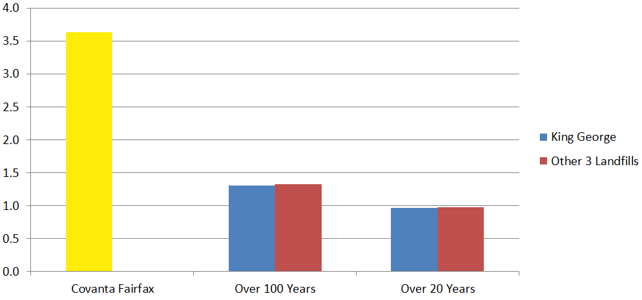
Nitrogen Oxide (NOx) Pollution
[Pounds of NOx per ton of waste disposed.]

Slide 74
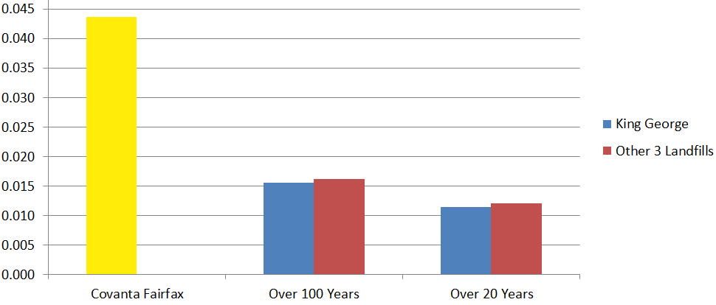
Particulate Matter Pollution
[Pounds of PM2.5 equivalent per ton of waste disposed.]

Slide 75
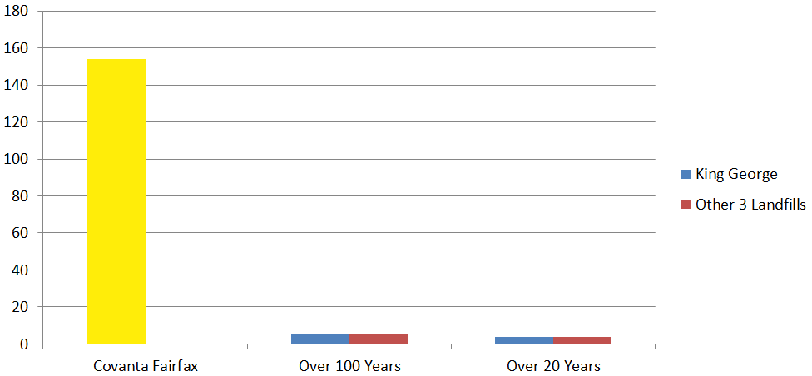
Toxic Pollution
[Pounds of toluene equivalent per ton of waste disposed.]
Does not include dioxin/furan emissions or ash leaching.

Slide 76
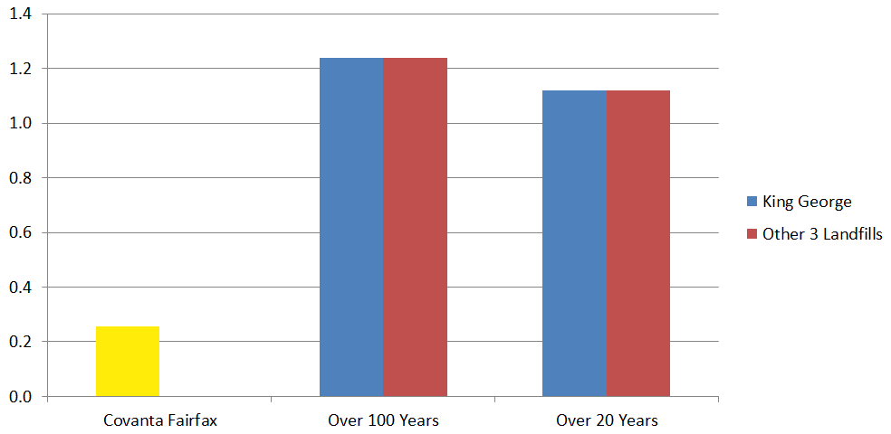
Carcinogenic Pollution
[Pounds of benzene equivalent per ton of waste disposed.]
Does not include dioxin/furan emissions or ash leaching.
Notes:
Largely formaldehyde from Internal Combustion Engines at landfills. King George uses gas turbines, which are much less polluting, but this study assumed all use IC engines.

Slide 77
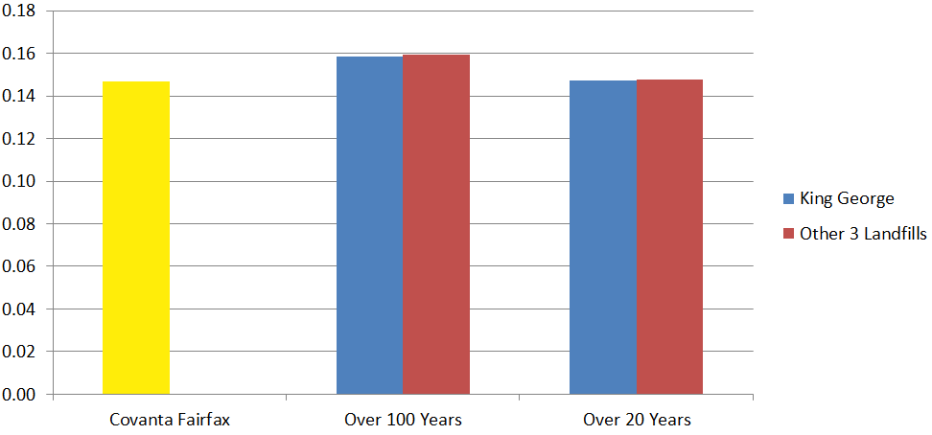
Eutrophication
[Pounds of nitrogen equivalent per ton of waste disposed.]
NOx and ammonia air emissions plus BOD, COD, phosphate, and ammonia water releases from landfills.

Slide 78
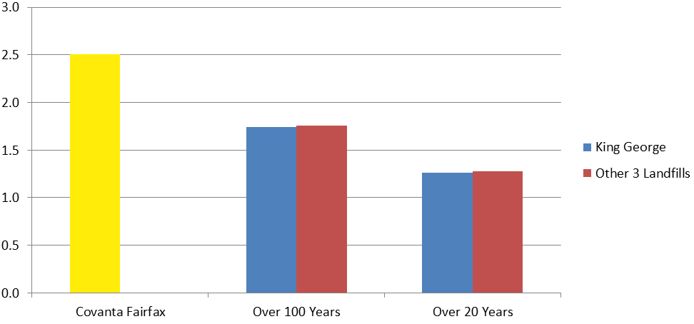
Acidification
[Pounds of SO₂ equivalent per ton of waste disposed.]
Incinerator emissions are largely from nitrogen oxides, but also include other acid gases (SO₂, HCl, HF). For the landfills, it’s hydrogen sulfide (H₂S) from the landfill, plus ammonia, NOx and SOx from the landfill gas burners.

Slide 79
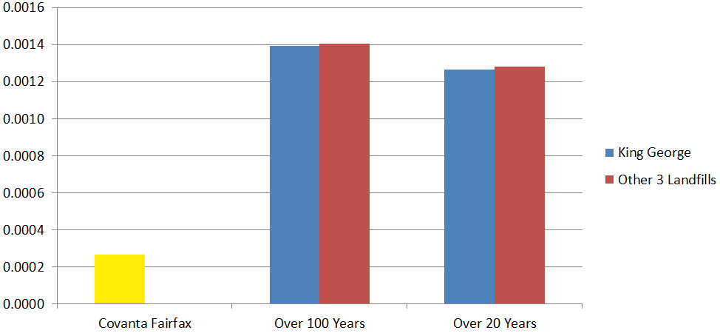
Ecosystems Toxicity
[Pounds of 2,4-D herbicide equivalent per ton of waste disposed.]
For the incinerator, this is mainly based on mercury emissions. For the landfill, mainly formaldehyde.

Slide 80
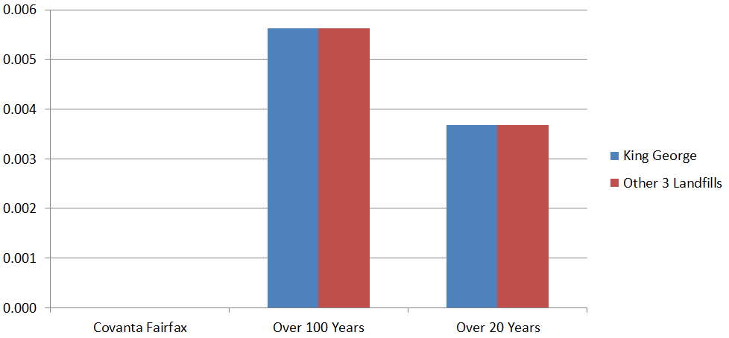
Ozone Depletion
[Pounds of CFC-11 equivalent per ton of waste disposed.]

Slide 81
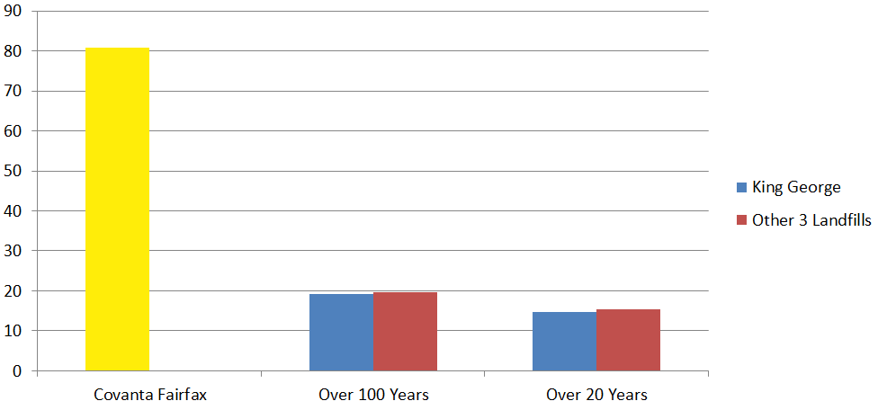
Smog Formation
[Pounds of ozone (O₃) equivalent per ton of waste disposed.]

Slide 82
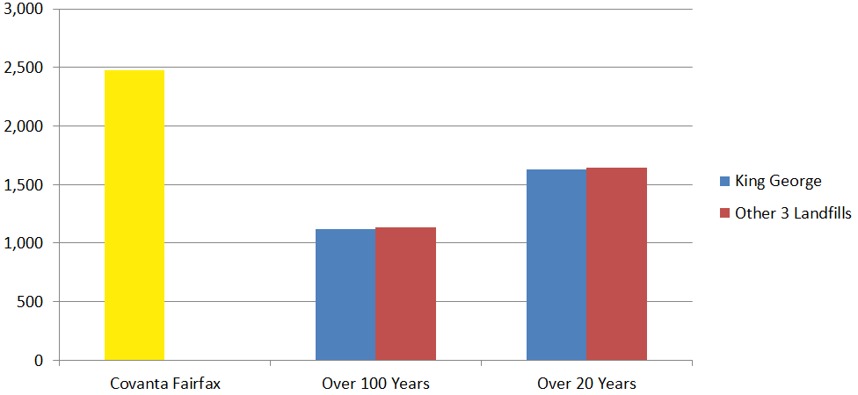
Global Warming Pollution
[Pounds of CO₂ equivalent per ton of waste disposed.]

Slide 83
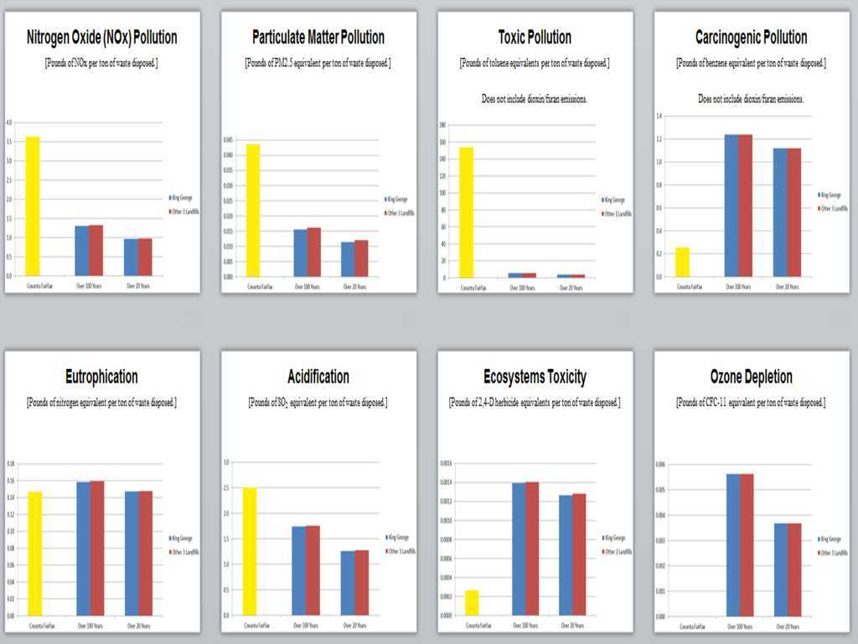
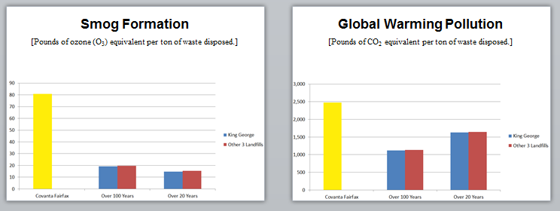
Incineration worse than Landfills

Slide 84
Trash Incineration (with ash landfilling)
is Worse than Landfills
Incineration is worse for:
Global warming
Toxic emissions
Nitrogen Oxide emissions (asthma)
Particulate Matter emissions
Acid rain
Smog
Cost
Number of people impacted
Environmental racism
Jobs
Landfills are worse for:
Ozone depletion
Carcinogenic emissions
Pesticide-like chemicals

Slide 85
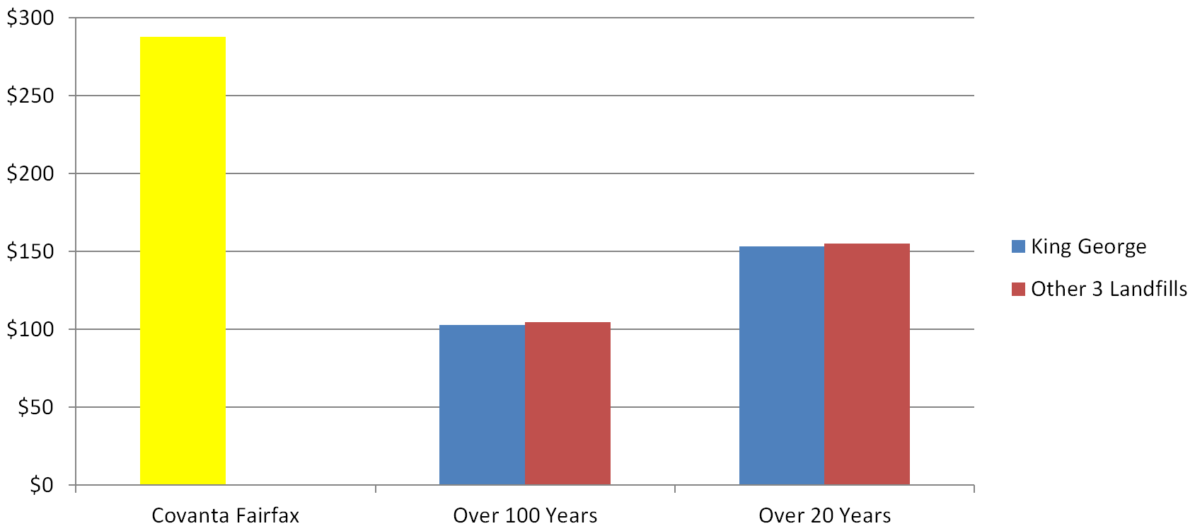
All together now…
Monetized Health & Environmental Cost
[All impacts combined and monetized.]
$288/ton for incineration vs. $103-155/ton for landfilling.
Covanta Montgomery County, MD

Slide 86
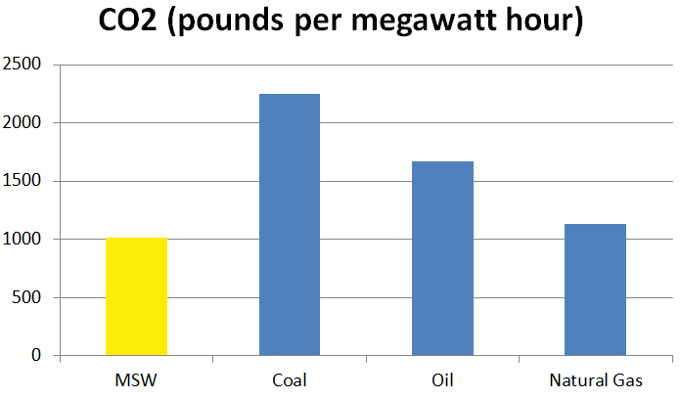
Global Warming Pollution
[EPA Public Relations on MSW Incineration]
Notes:
https://archive.epa.gov/epawaste/nonhaz/municipal/web/html/airem.html

Slide 87
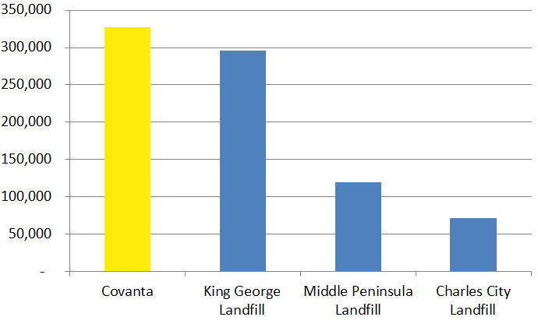
Global Warming Pollution
[EPA FLIGHT Data in 2015 metric tons CO2 equivalent.]
NOTE: This ignores biogenic emissions from incineration, but not from landfills, making Covanta seem half as bad as they are.
Notes:
All from https://ghgdata.epa.gov/ghgp/main.do
Covanta 327,236 2015 metric tons CO2e https://ghgdata.epa.gov/ghgp/service/facilityDetail/2015?id=1006177&ds=E&et=&popup=true
King George Landfill 295,880 2015 metric tons CO2e https://ghgdata.epa.gov/ghgp/service/facilityDetail/2015?id=1007674&ds=E&et=&popup=true Middle Peninsula Landfill 119,041 2015 metric tons CO2e https://ghgdata.epa.gov/ghgp/service/facilityDetail/2015?id=1007635&ds=E&et=&popup=true Charles City Landfill 71,668 2015 metric tons CO2e https://ghgdata.epa.gov/ghgp/service/facilityDetail/2015?id=1007583&ds=E&et=&popup=true

Slide 88
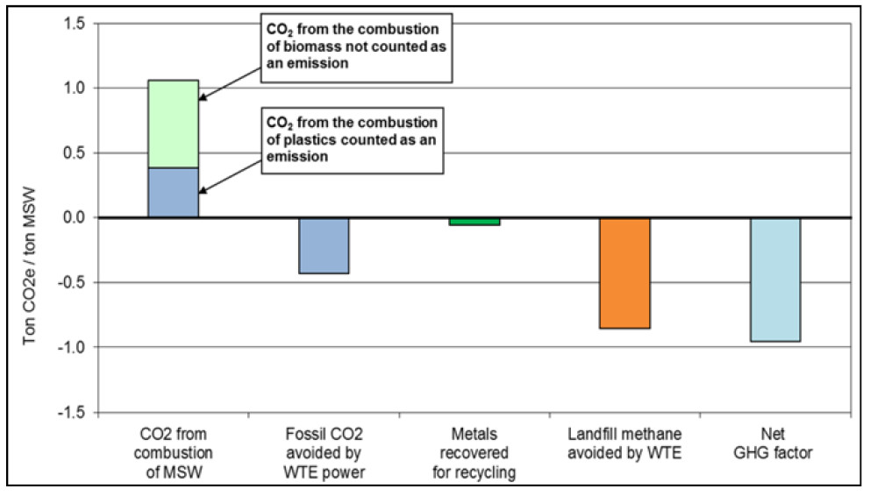
Global Warming Pollution
[Energy Recovery Council Public Relations on MSW Incineration]

Slide 89


Sponsored by the incinerator industry, with $50-100K/year from…

Slide 90


Ray of sunshine encounters a CO₂ molecule in the atmosphere...
Ray of sunshine: Did you come from a tree?
CO₂ molecule: Why yes, I did!
Ray of sunshine: Ok, I won't heat you up, then. Have a nice day!
(This is NOT how it works. There is no “magic tree carbon.”)

Slide 91
Ray of sunshine encounters a CO₂ molecule in the atmosphere...
Ray of sunshine: Did you come from a tree?
CO₂ molecule: Why yes, I did!
Ray of sunshine: Ok, I won't heat you up, then. Have a nice day!
(This is NOT how it works. There is no “magic tree carbon.”)
WHY? 1) Double Counting
2) Carbon in trees/plants/soils isn’t same as in air
3) Don’t have time

Slide 92
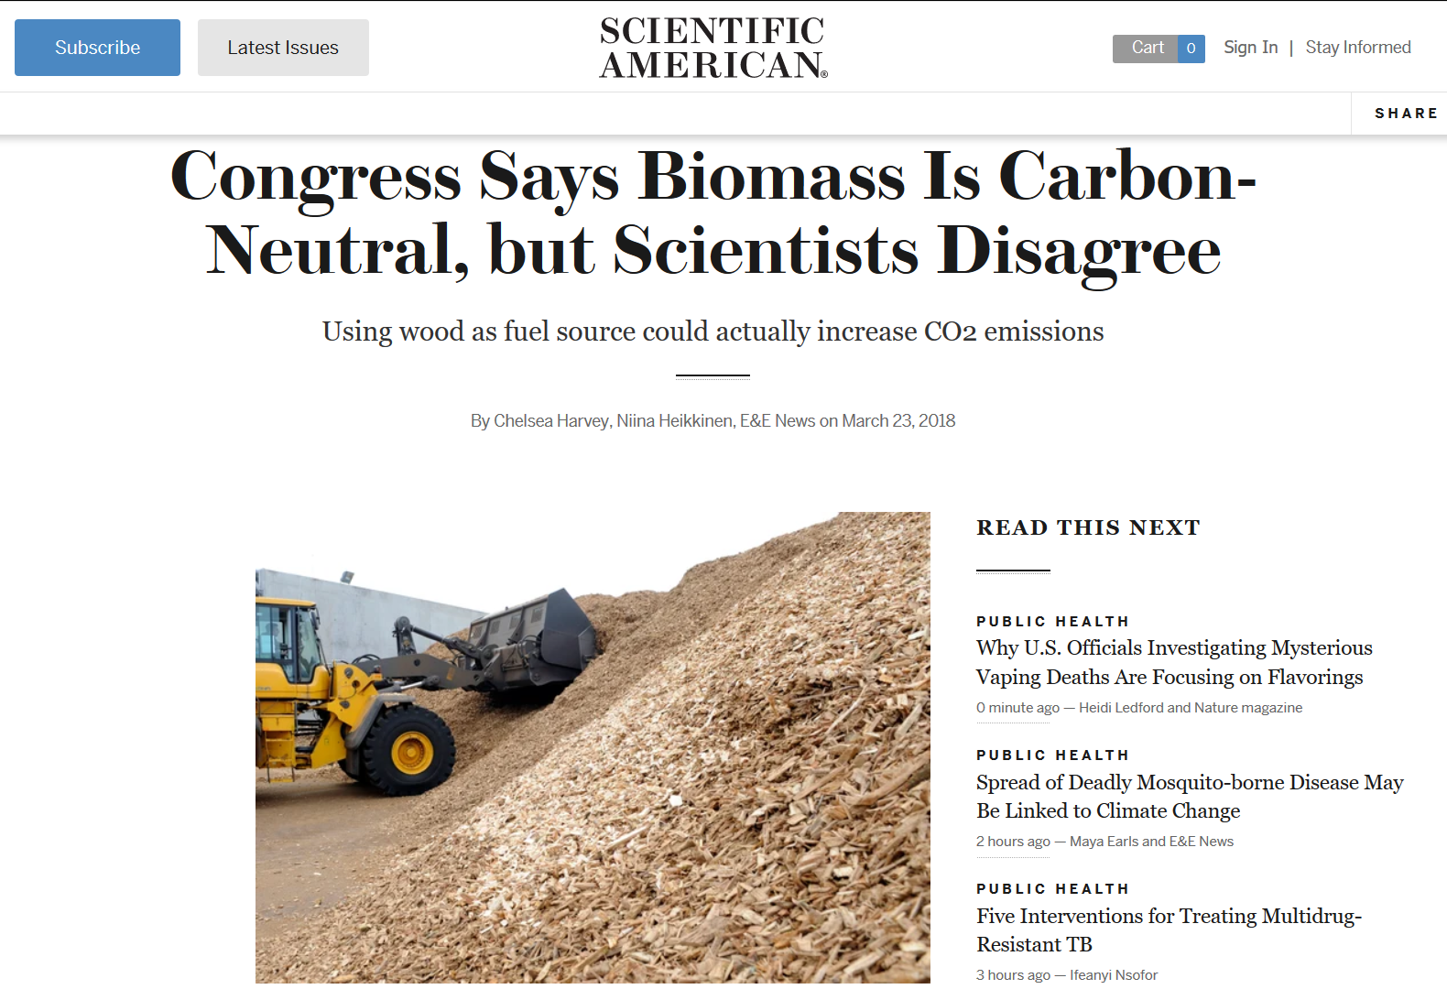

Slide 93
How incineration GHGs downplayed
Ignoring the “biogenic” half of carbon emissions from incinerators while counting all of the GHGs (all “biogenic”) from landfills.
  Biomass carbon neutrality has been scientifically debunked. See a compilation of the science here: www.energyjustice.net/biomass/carbon
Pretending “biogenic” carbon’s share in MSW is larger than the 52.7% that EPA factors into their eGRID data.
  The trend should be the opposite, with newspapers disappearing and plastic packaging replacing glass.
Subtracting avoided methane emissions from landfills, as if conventional landfills are the only alternative.
  Invalid when comparing incinerators to landfills, as the same assumption could be made for landfills, letting them subtract incinerator emissions.
Subtracting emissions from offsetting fossil fuel electricity
  …as if they’re not actually competing with wind power within the state’s Renewable Portfolio Standard law.
Details at: www.energyjustice.net/incineration/climate

Slide 94

Global Warming Pollution
[Pounds of CO₂ equivalent per ton of waste disposed.]
(Displacing wind / no energy displacement factored in)

Slide 95

Global Warming Pollution
[Pounds of CO₂ equivalent per ton of waste disposed.]
(Displacing Coal)

Slide 96
Evaluating Energy Displacement
Even if we assume that coal power is being displaced, incineration comes out 10% worse for the climate than coal in the short term
(20-years), and 113% worse than (2.1 times as bad as) landfilling in the long-term (100 years).
Coal displacement is an extreme assumption, and completely unlikely:
  No one is building new coal power plants anymore.
  Coal assets are being retired rapidly across the country. Coal mining companies are going bankrupt.
  U.S. coal production has peaked in 2002 in terms of energy value extracted, leaving the more expensive and harder to reach coal deposits, most of which will never be extracted because gas, and increasingly wind and solar, are undercutting and replacing coal.

Slide 97

“In our industry, and in the waste industry as
a whole, fires are becoming more prevalent.”
-Mark Harlacker – Covanta’s Commercial Business Director for Mid-Atlantic Region, 4/26/2017 testimony before DC City Council
Notes:
Washington, DC City Council Committee on Transportation and the Environment, Department of Public Works Budget Hearing, April 26, 2017. http://dc.granicus.com/MediaPlayer.php?view_id=2&clip_id=3913 at 53:20.
For main image of Feb 2, 2017 fire at Covanta’s Lorton, VA incinerator, see second video on this page for helicopter footage from which this main image was taken:
https://www.nbcwashington.com/news/local/Firefighters-Respond-Blaze-Trash-Disposal-Center--412635913.html

Slide 98

Notes:
https://www.montgomerycountymd.gov/SWS/Resources/Files/rrf/RCA%20Documents.pdf – see PDF page 89 (second to last page)

Slide 99




Trash Incinerator Health Impacts

Slide 100
Health effects…
Air Pollutant | Health Effects
Nitrogen Oxides | triggers asthma attacks, increases lifetime risk of chronic respiratory disease and stroke
Sulfur Dioxide | triggers asthma attacks, increases lifetime risk of chronic respiratory and heart diseases and stroke
Hydrochloric Acid | irritates eyes, skin, and nose, damages lungs
Carbon Monoxide | causes headaches and dizziness; increases lifetime risk of heart disease
Particulate matter (soot) | heart attacks, stroke, irregular heartbeat, aggravated asthma, decreased lung function, difficulty breathing
Fine Particulate matter | same as above, but worse, as it can get deep into lungs and into blood stream
Volatile Organic Compounds | eye, nose and throat irritation, headaches, loss of coordination and nausea, liver, kidney and central nervous system damage, cancer
Formaldehyde | irritates eyes, skin, and nose, increases lifetime risk of cancer
Hydrogen Fluoride | lung, liver, and kidney damage, skeletal fluorosis (brittle bones)
Lead | causes damage to nervous system and kidneys, lowers IQ in children, increases likelihood of antisocial behavior
Mercury | causes damage to nervous, digestive, and immune systems, lowers IQ in children
Nickel | lung and nasal cancers
Chromium (VI) | lung cancer, shortness of breath, coughing, and wheezing

Slide 101

Health effects
People living near incinerators have an increased risk of…
All types of cancer, including:
  Stomach
  Colorectal
  Liver
  Renal
  Lung & pleural
  Gallbladder
  Bladder
  Non-Hodgkin lymphoma
  Leukemia
  Soft-tissue sarcoma
Respiratory diseases & symptoms
Cardiovascular diseases
Urinary diseases
Source: www.energyjustice.net/incineration/healthstudies.pdf

Slide 102

Racism isn’t usually this obvious…
Zulene Mayfield shows signs of vandalism at office of Chester Residents Concerned for Quality Living in Chester, PA in 1996 “Laid to Waste” documentary.

Slide 103

www.ChesterResidents.org

Slide 104

Who Lives Near Trash Incinerators?
Source: www.spatialjusticetest.org/test/14.html

Slide 105

Who Lives Near Trash Incinerators?
Source: www.spatialjusticetest.org/test/14.html

Slide 106

Who Lives Near Landfills?
Source: www.spatialjusticetest.org/test/16.html

Slide 107

Zero Waste Jobs
Deconstruction Crew, Second Chance, Baltimore, MD. Photo Credit: C. Seldman

Slide 108
What is Zero Waste?
“The conservation of all resources by means of responsible production, consumption, reuse, and recovery of all products, packaging, and materials, without burning them, and without discharges to land, water, or air that threaten the environment or human health.”
Source: Zero Waste International Alliance, www.zwia.org

Slide 109
If you’re not for Zero Waste, how much waste are you for?
Zero Waste means zero incineration and achieving 90% or greater diversion from landfills and other forms of destructive disposal.
The goal is to get as close to zero as possible, without getting caught up on the impossibility of actually hitting zero.
“Zero waste” is like “zero drug tolerance” or “zero accidents in the workplace” standards. Zero is the goal, and the right policies will get you as close as you can get.

Slide 110


Slide 111


Getting to Zero Waste
Unit pricing, a.k.a. “Pay/Save as You Throw” or “Save Money and Reduce Trash” (SMART)
Free bins – and the right sizes!
Composting
Deconstruction

Slide 112

Residential MSW Disposed per Capita – DEEP Dive Participants
SMART communities dispose of less residential MSW per capita than most Connecticut cities and towns. Worcester throws away 324 lbs. per capita.
MA SMART Towns
432
CT Average
740
Mansfield
CT
513
Stonington
CT
389
Worcester
MA
324
Note: Figures are calculated using MSW tonnage data provided by the municipalities themselves

Slide 113




Results: MSW Reduction of 44% on Average
SMART / ‘Unit Based Pricing’ is a science. The data spans over decades across hundreds of municipalities with diverse demographics.
Waterville, ME
53% Decline in Waste
Dartmouth, MA
59% Decline in Waste
Natick, MA
35% Decline in Waste
Sanford, ME
40%+ Decline in Waste…Twice

Slide 114

Expected Waste Shift from SMART (40 DEEP Dive Participants)
Overall waste generation is expected to decrease by about 21% due to source reduction and reuse.
​
20%
(115,688 tons)
21%
Less Generation
MSW
80%
(469,620 tons)
​
43%
(198,447 tons)
MSW
57%
(262,919 tons)

Slide 115
Net Effect of SMART in Current Recycling Market (40 DEEP Participants)
Recycling markets have been weak for the past few years due to a combination of single stream contamination and China’s policy. The recycling infrastructure in the US is adjusting and markets are predicted to rebound. Recycling is a commodity and there will always be highs and lows. However, SMART is the best way to manage waste regardless of the recycling costs because it promotes source reduction and reuse. The recycling tip fee could go as high as $170 per ton, and a SMART system will still cost less money.
 | No SMART | SMART | No SMART | SMART | No SMART | SMART | No SMART | SMART
Waste Tonnage | 1,019,367 | 570,778 | 1,019,367 | 570,778 | $1,019,367 | $570,778 | $1,019,367 | $570,778
Recycling Tonnage | 268,067 | 449,136 | 268,067 | 449,136 | $268,067 | $449,136 | $268,067 | $449,136
Waste Tip | $75 | $75 | $75 | $75 | $75 | $75 | $75 | $75
Recycling Tip | $0 | $0 | $40.00 | $40.00 | $80.00 | $80.00 | $170 | $170
Trash Disposal $ | $76,452,541 | $42,808,335 | $76,452,541 | $42,808,335 | $76,452,541 | $42,808,335 | $76,452,541 | $42,808,335
Recycling $ |  |  | $10,722,665 | $17,965,440 | $21,445,331 | $35,930,879 | $45,571,328 | $76,353,118
Total Cost | $76,452,541 | $42,808,335 | $87,175,206 | $60,773,774 | $97,897,871 | $78,739,214 | $122,023,869 | $119,161,453
Savings - Comparison |  | $33,644,206 |  | $26,401,432 |  | $19,158,658 |  | $2,862,416
The waste tip fee is expected to rise significantly over the next decade. The average waste tip fee for the 40 DEEP DIVE communities was $75 per ton. Most communities are tied to a CPI price escalator. Communities that have negotiated new contracts since the start of the program have seen much greater increases than CPI.

Slide 116
Money Thrown Away
$11.4 billion worth of recyclable packaging wasted (sent to landfills and incinerators) in 2010
Source: “Unfinished Business: The Case for Extended Producer Responsibility,” 2012 Report, www.asyousow.org/sustainability/eprreport.shtml

Slide 117


Slide 118



Slide 119

EPA’s
https://www.epa.gov/smm/sustainable-materials-management-non-hazardous-materials-and-waste-management-hierarchy

Slide 120

www.zwia.org/zwh
Notes:
www.zwia.org/zwh

Slide 121
Zero Waste Hierarchy
Rethink / Redesign
Reduce
Source Separate:
  Reusables
  Recycle (multi-stream)
  Compost
  Waste
    Research to see what is left, and encourage redesign
    Recovery: mechanically remove additional recyclables
    Anaerobically digest, then aerobically compost residuals
    Stabilized (digested) residuals to landfill
www.energyjustice.net/zerowaste

Slide 122

The back end is still a landfill…
Direct landfilling
(bad, but better than incineration)
  leachate (toxics)
  air emissions (toxics, methane, odors)
Incineration → toxic ash to landfill
(most polluting and expensive option)
  leachate (even more toxics)
  air emissions from ash blowing off site (toxics)
Anaerobic digestion → landfill
(best option; avoids gassy, stinky landfills)
  odor, leachate and air emissions highly minimized

Slide 123


Slide 124


Slide 125


Slide 126

Better to Landfill than Burn Plastics

Slide 127

Compostable Plastics
Polylactic Acid (PLA)
  Made from biotech corn
  Glyphosate (Roundup) spraying
    Cancer; kills / mutates amphibians
  Estrogen-like chemical leaching
Consumers confused where to put it
  Recycling:
    Contaminates recycling
  Composting:
    Often not available, consumers don’t know if going to industrial facility that can handle it
  Trash:
    Worse than plastics in landfill; both bad if burned

Slide 128

Messing with your hormones…
Source: www.motherjones.com/environment/2014/03/guide-estrogen-common-plastics-bpa/; more at www.ejnet.org/plastics

Slide 129
For more Info…
Incineration:
  www.EnergyJustice.net/incineration
  www.EnergyJustice.net/biomass
Landfills and Landfill Gas Burning:
  www.EnergyJustice.net/lfg
  www.ejnet.org/landfills
Zero Waste:
  www.EnergyJustice.net/zerowaste
  www.ilsr.org/initiatives/waste-to-wealth
  www.grrn.org/zerowaste
  www.zwia.org

Slide 130

Mike Ewall, Esq.
Founder & Director
215-436-9511

